Slide 1

The Food Equation: Balancing Demand and Pricing with Data-Driven Forecasts
Professor : Masoud Soroush
Team 4 :
Deepika Bangari(TU80531)
Lokesh Reddy Kuppireddy(GR68330)
Rishi Dasari(TN73813)

Slide 2

Introduction
Businesses face a complex challenge in balancing the delicate relationship between demand and pricing.
On one hand, pricing impacts customer demand directly, while on the other, demand determines inventory management and profitability.
Missteps in balancing these two can disrupt operations, affect customer satisfaction, and hurt overall revenue.

Slide 3
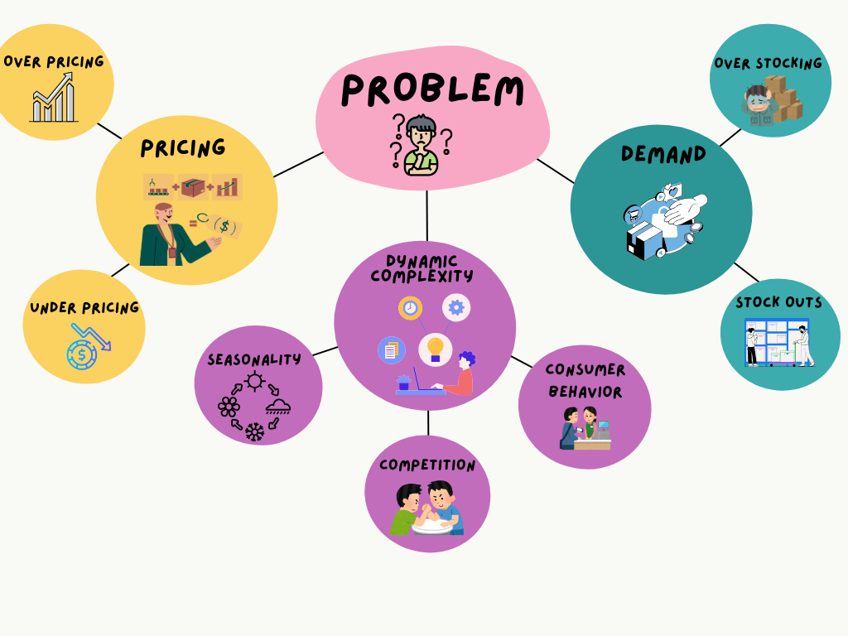
Introduction
Businesses often struggle with finding the right balance between demand and pricing.
Overpricing may reduce demand, while underpricing leads to revenue loss.
Imbalances result in operational inefficiencies, such as:
Overstocking, which increases holding costs and waste.
Stockouts, causing missed sales opportunities and customer dissatisfaction.
Dynamic factors like seasonality, competition, and consumer behavior add complexity.

Slide 4

BUSINESS UNDERSTANDING

Slide 5
PROBLEM STATEMENT
01
03
02
04
Price Sensitivity:
Inventory Management Issues
Retailers face difficulties in quantifying the price elasticity of high-demand food categories, impacting their ability to develop effective and revenue-maximizing pricing strategies.
Inefficient inventory practices, driven by inaccurate demand predictions and price changes, often result in overstock, waste, or stockouts, affecting both profitability and sustainability.
Seasonal & Regional Fluctuations
Need for Data-Driven Insights
Demand for food items varies significantly based on seasonality and regional differences, making it challenging to forecast consumption trends.
Robust, data-driven models that incorporate socioeconomic factors like employment and labor force data are needed to inform better inventory and pricing decisions.

Slide 6
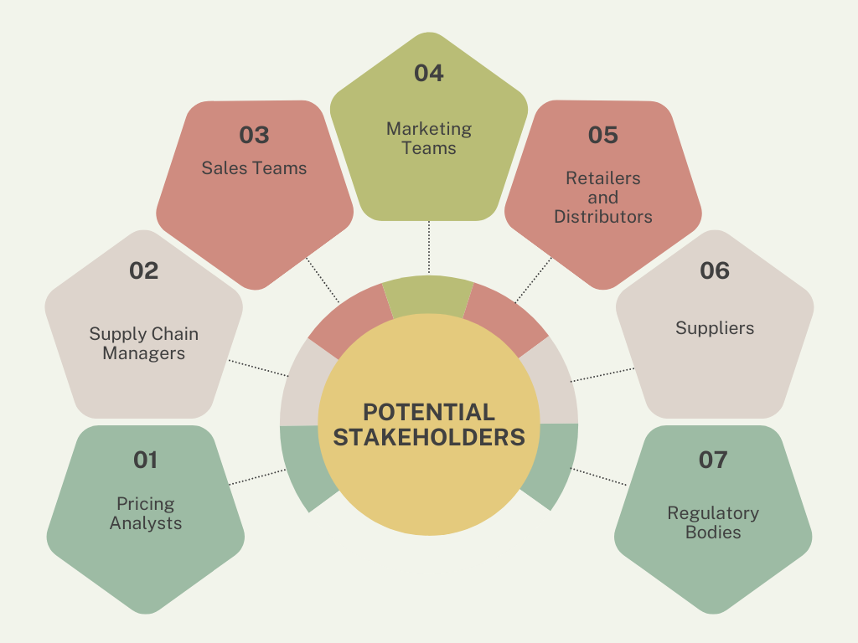
POTENTIAL STAKEHOLDERS
Pricing Analysts: Develop pricing strategies to maximize revenue while staying competitive.
Supply Chain Managers: Align inventory, production, and logistics with forecasted demand to minimize waste and stockouts.
Sales Teams: Execute pricing strategies to drive sales and revenue.
Marketing Teams: Use demand forecasts to design targeted campaigns and optimize discounts.
Retailers/Distributors: Ensure supply and pricing meet consumer expectations to maximize margins.
Suppliers: Align production schedules with demand forecasts.
Regulatory Bodies: Ensure compliance with laws and promote fair trade practices.

Slide 7

DATA UNDERSTANDING

Slide 8
DATA COLLECTION: From Source to Strategy
Food Pricing Data (USDA ERS)
Economic Data (BLS)
DataSet : U.S. Department of Agriculture, Economic Research Service. (2024). Food-at-Home Monthly Area Prices https://www.ers.usda.gov/data-products/food-at-home-monthly-area-prices
Provides comprehensive monthly food price data for 90 categories across key U.S. metro areas and regions, covering 2012 to 2018.
Data was downloaded in CSV format, including unit values and multiple price indexes for efficient integration and analysis
DataSet : Bureau of Labor Statistics. (2024). Labor Force Statistics. Retrieved from https://www.bls.gov.
Captures essential economic indicators like labor force, employment, and unemployment rates.
CSV files were downloaded separately for each region and each year, ensuring detailed and region-specific economic data for our analysis.
Data sourced from reputable government agencies, ERS and BLS, ensuring rigorous, unbiased, and up-to-date information.

Slide 9
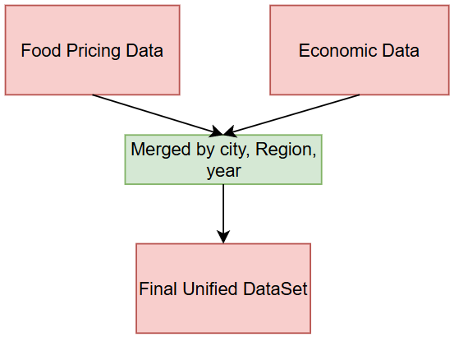
Covers national, regional (4 census regions), and metropolitan data over multiple years and months, enabling robust time series analysis.
The dataset provides detailed insights for 10 metropolitan areas, leveraging publicly accessible data from trusted government sources like USDA ERS and BLS. Expanding beyond these regions would require additional permissions, presenting an opportunity for future collaboration to enhance the breadth of analysis.
Alignment by Key Attributes: Merged food pricing data (ERS) with economic data (BLS) using key attributes like city, region, month and year to ensure accurate integration.
Standardized Formats: Ensured consistency by converting all variables into a uniform format, such as aligning time periods and standardizing geographic labels.
Efficient Data Handling: Used CSV files for seamless data manipulation, enabling straightforward merging and efficient data processing.
Final Unified Dataset: Created a comprehensive dataset that combines economic and food pricing information (contains 113,400 rows).

Slide 10
DATASET DESCRIPTION
Variable name/column | Description | Data type
Year | Year of data | Numeric
Month | Month of data | Numeric
Labor Force | Total number of people employed or actively seeking work. | Numeric
Employment | Total number of people currently employed in the labor force. | Numeric
Unemployment | Total number of people in the labor force who are jobless but actively seeking work. | Numeric
Unemployment rate | Percentage of the labor force that is unemployed and actively seeking work. | Numeric
EFPG_name | ERS Food Purchase Group (EFPG) label | Character
EFPG_code | ERS Food Purchase Group (EFPG) code | Numeric
Metroregion_name | Geographic area label | Character
Metroregion_code | Geographic area code | Numeric
Purchase_dollars_wtd | Total weighted monthly sales in U.S. dollars (nominal, i.e., not adjusted for inflation) | Numeric
Purchase_grams_wtd | Total weighted monthly quantities in grams | Numeric
Purchase_dollars_unwtd | Total unweighted monthly sales in U.S. dollars (nominal, i.e., not adjusted for inflation) | Numeric
Purchase_grams_unwtd | Total unweighted monthly quantities in grams | Numeric
Number_stores | Number of stores in geographic area | Numeric
Unit_value_mean_wtd | Weighted mean unit value per 100 grams | Numeric
Unit_value_se_wtd | Standard error of weighted mean unit value | Numeric
Unit_value_mean_unwtd | Unweighted mean unit value per 100 grams | Numeric
Price_index_GEKS | Price index, constructed using Gini-Elteto-Koves-Szulc (GEKS) | Numeric

Slide 11

DATA PREPARATION

Slide 12
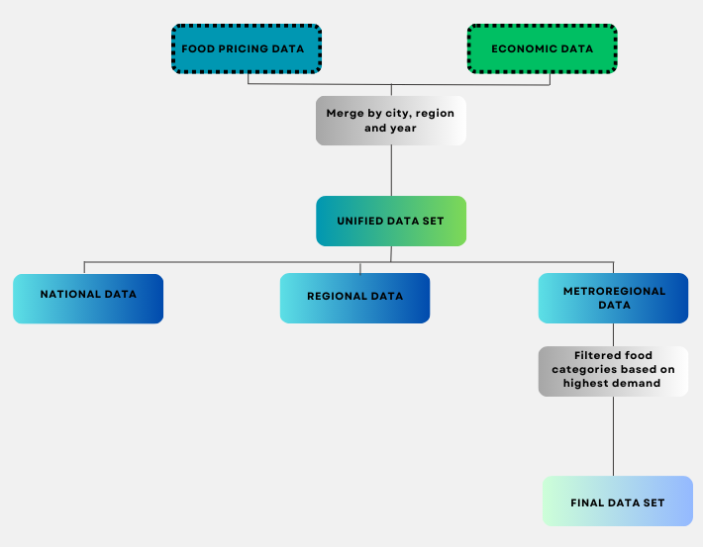
DATA PREPROCESSING AND CATEGORIZATION
Food Pricing Data and Economic Data are merged based on city, region, and year to create a Unified Data Set. This dataset is then segmented into three levels of analysis:
National Data, providing aggregated insights at a high level.
Regional Data, offering localized trends by specific regions.
Metro-regional Data, focusing on metropolitan areas.
Filtering food categories based on highest demand, the output is a Final Data Set that delivers actionable insights into high-demand food categories, tailored for metro-regional analysis.

Slide 13
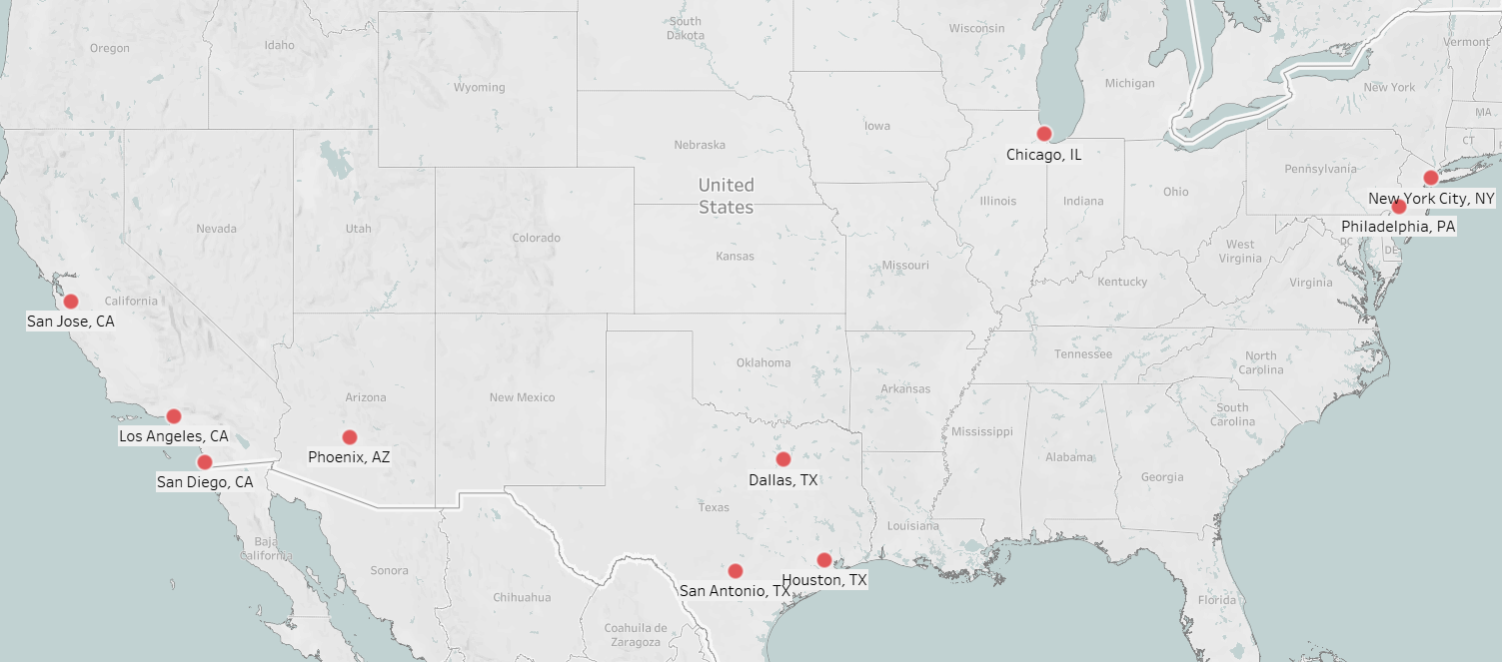
DATA PREPROCESSING AND CATEGORIZATION
Dataset is complete, with no missing values, ensuring a robust and accurate analysis.
Divided data into national, regional (Northeast, Midwest, South, West regions), and city-level categories for more precise analysis.
We have selected below 10 food categories based on highest demand.
Alcohol | All other caloric beverages
Frozen refrigerated ready-to-heat foods | Beef, pork, lamb, veal, and game, fresh
Bacon, sausage, and lunch meats | Cheese
Canned soups | Non-caloric beverages
Milk, fresh | Eggs

Slide 14
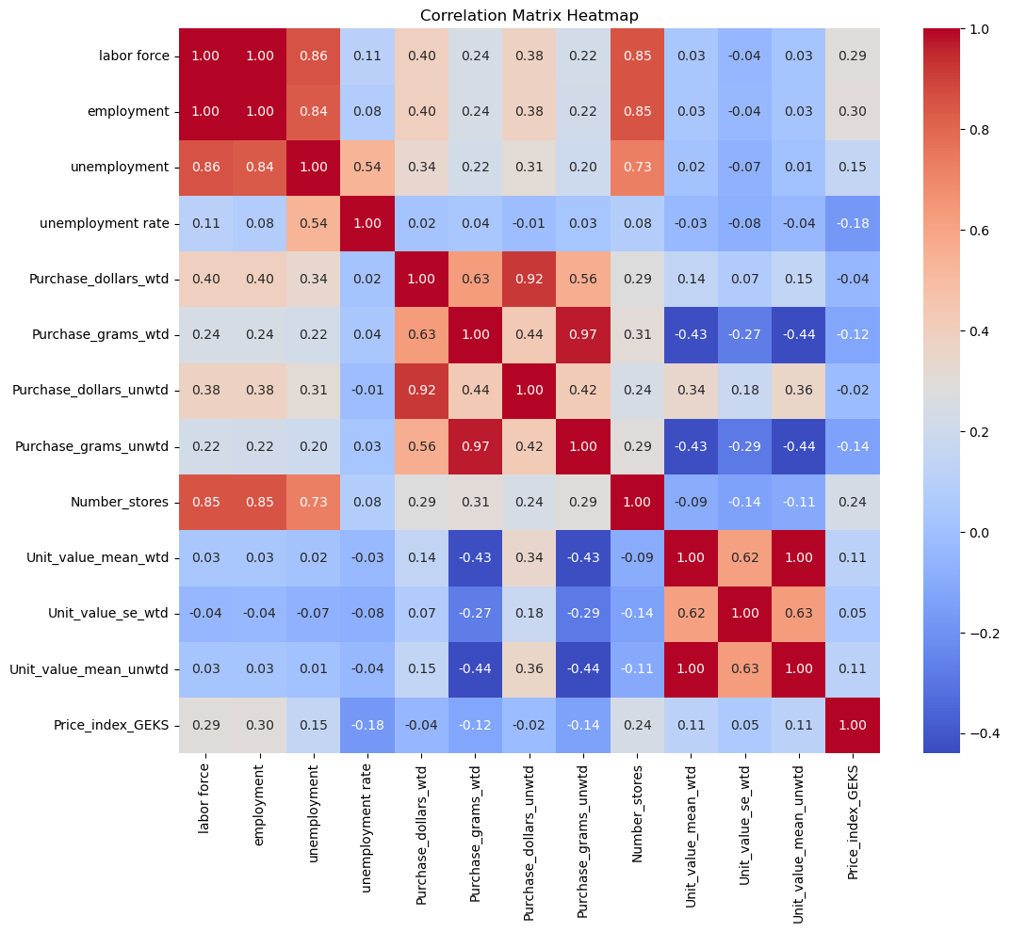
Key Insights from Correlation Analysis
Number_stores shows a positive correlation (0.31) with Purchase_grams_wtd, indicating that regions with more stores experience higher purchase quantities, emphasizing the importance of retail availability.
Unit_value_mean_wtd has a moderate negative correlation (-0.43) with Purchase_grams_wtd, showcasing the model’s ability to capture how higher prices lead to reduced purchase quantities.
Including Price_index_GEKS adds valuable regional price-level information, allowing the model to account for geographic pricing differences and their subtle influence on purchasing behavior.
Labor force contributes positively (0.24) to Purchase_grams_wtd, reflecting the role of economic activity and population engagement in driving purchase behavior.

Slide 15
IMPACT OF CATEGORICAL VARIABLES ON TARGET
ANOVA:
Determines if there are statistically significant differences in the target variable (Purchase_grams_wtd) across different categorical groups (EFPG_name and Metroregion_name).
Helps identify the influence of categorical variables on demand trends.
Implications:
Both food categories and metro regions are critical predictors for demand trends.
These results validate the inclusion of EFPG_name and Metroregion_name as key features in machine learning models.
METRIC | Metroregion_name | EFPG_name
F-statistic | 67.73 | 3160.32
P-value | 5.7e-121 | 0.001

Slide 16
Research Questions
What seasonal and regional demand patterns can be identified for top food categories, and how can these patterns be used to forecast future consumption trends across U.S. metropolitan regions?
How can demand forecasting be used to optimize inventory management and minimize food waste for key food categories in U.S. food retailers?
How can regional and socioeconomic conditions influence sales optimization for high-consumption food products in U.S. retail markets?
How can price elasticity of demand be quantified for key high-spend and high consumption food categories?

Slide 17
SEASONALITY
Seasonality:
Recurring patterns or trends in demand across different times of the year, influenced by seasons.
To identify and analyze seasonal variations in consumer purchases to optimize inventory, marketing, and pricing strategies.
Examined purchase trends across metro regions for key product categories, segmented by seasons.
Seasonal demand variations reveal significant opportunities for tailored interventions in high-consumption periods.

Slide 18
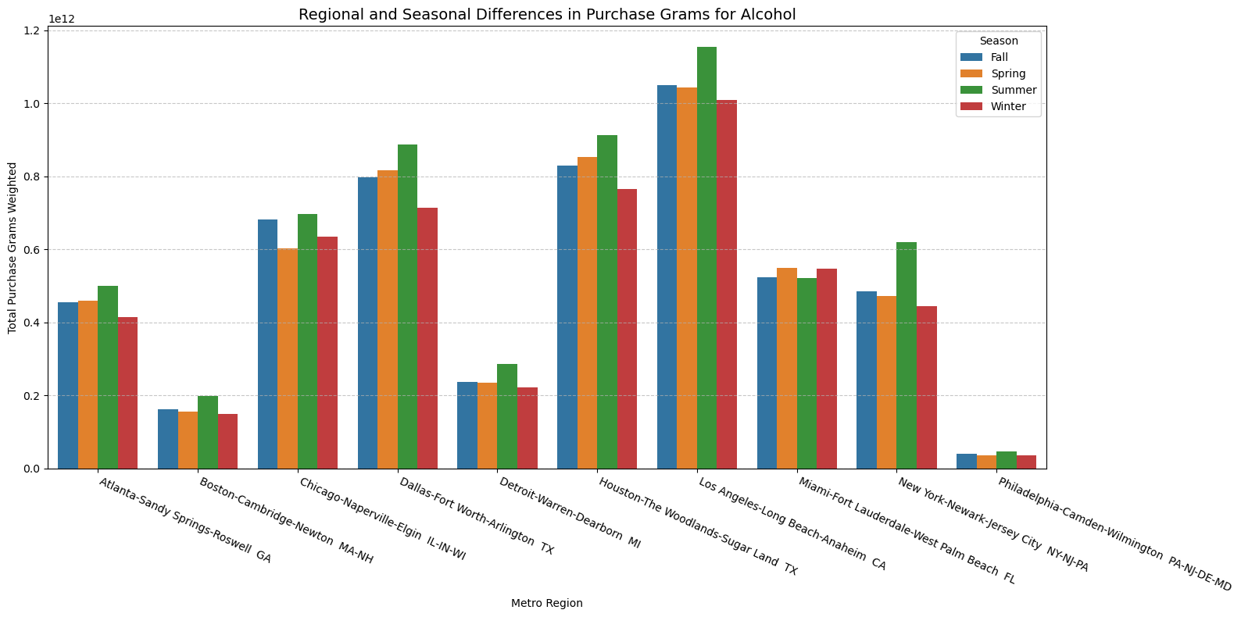
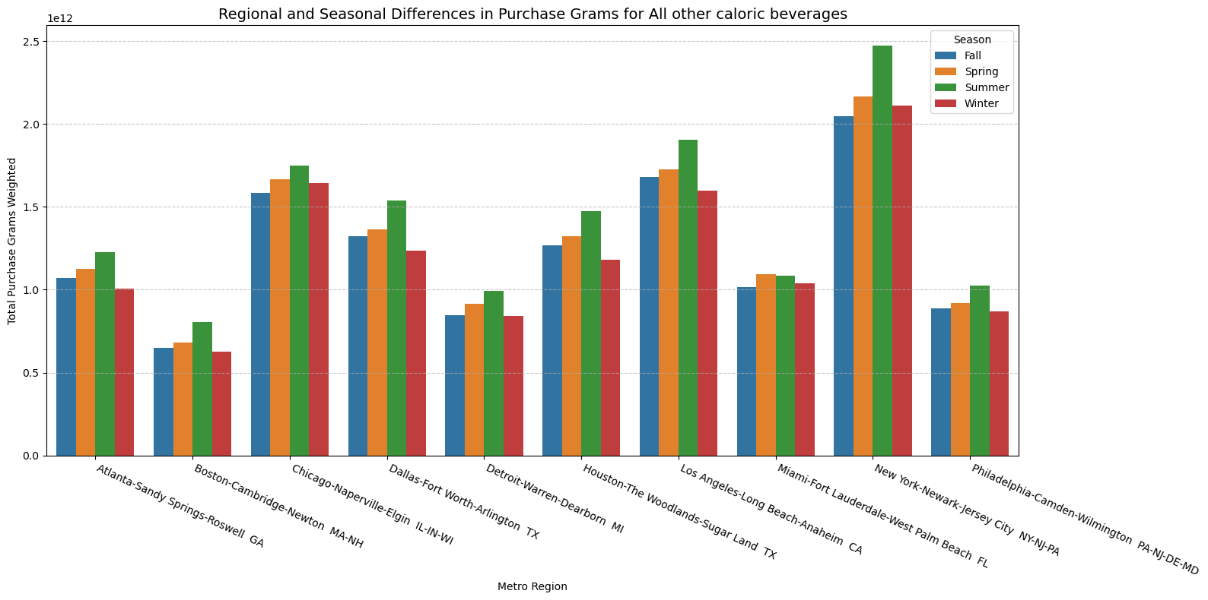
02
04
Seasonal & Regional Fluctuations
Need for Data-Driven Insights
Alcohol:
High demand in Summer , driven by holidays and celebrations.
Relatively lower volumes in Winter and Spring.
Los Angeles-Long Beach-Anaheim-CA consistently shows the highest demand.
All Other Caloric Beverages:
Peaks in Summer, reflecting increased outdoor activities and heat-related consumption.
Moderate demand in other seasons.
New York-Newark-Jersey City NY-NJ-PA leads in
purchases because of its higher population.
Other notable regions: Chicago-Naperville-Elgin IL-IN-WI
and Los Angeles-Long Beach-Anaheim CA.

Slide 19
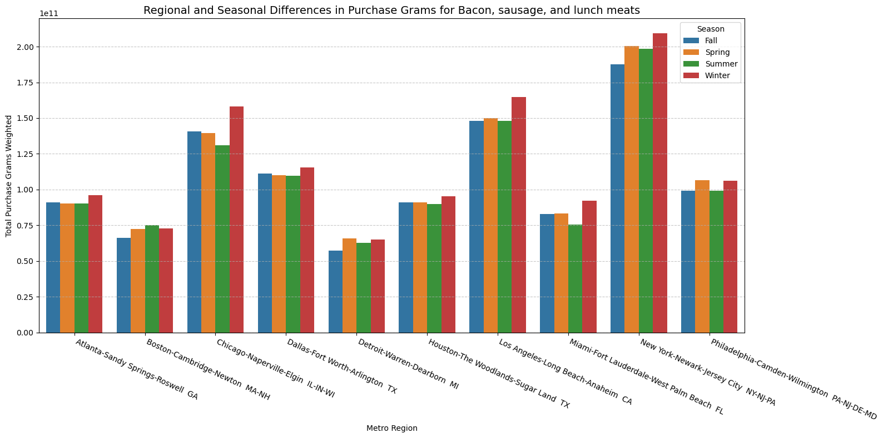
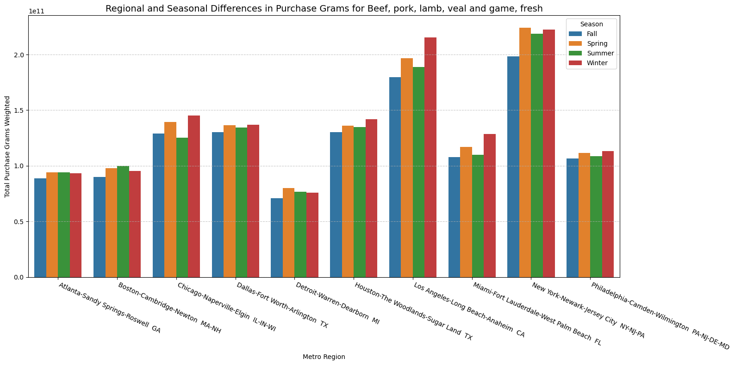
Bacon, Sausage, and Lunch Meats
High demand in Winter, suggesting increased usage in hearty breakfasts and comfort foods.
Lower demand during Summer, possibly due to fewer cooked meals at home.
Beef, Pork, Lamb, Veal, and Game (Fresh)
Steady demand during other seasons, with slight dips in fall.
Higher demand for fresh meats during holidays and colder months for roasts and stews.

Slide 20
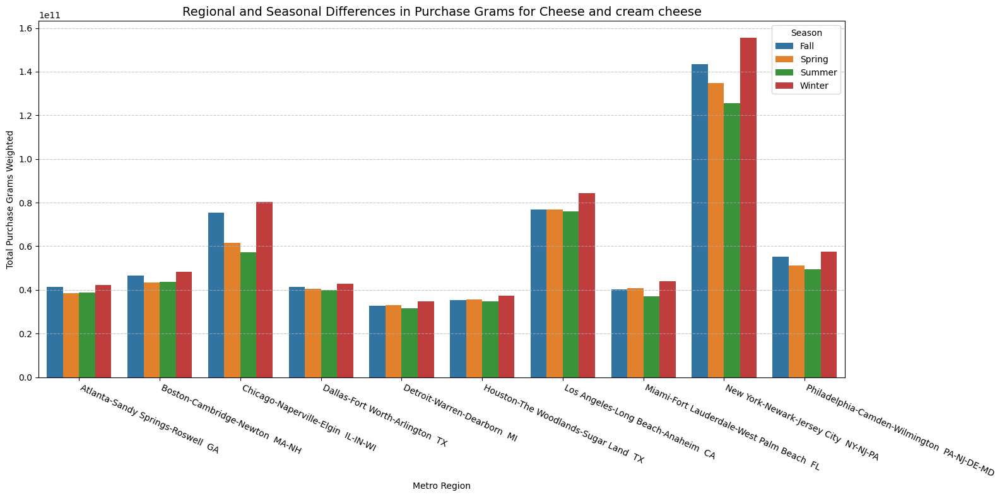
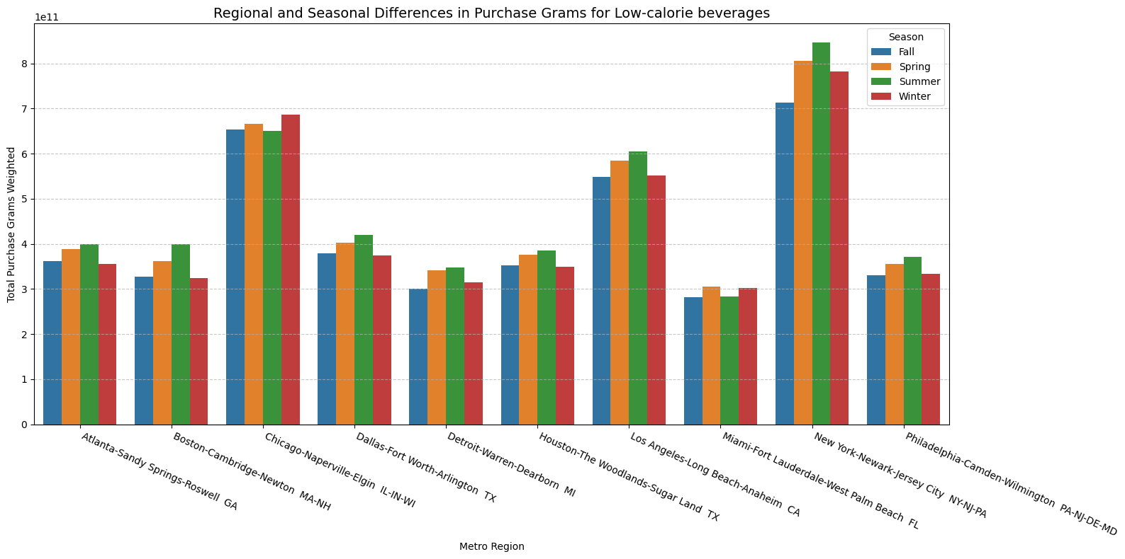
Cream and cream cheese:
Consistent demand year-round, with a notable peak in Winter.
High Winter demand may be tied to holiday cooking, baking, and comfort foods.
Low-Calorie Beverages:
Increased focus on health and hydration during hot weather.
Noticeable Summer peaks

Slide 21
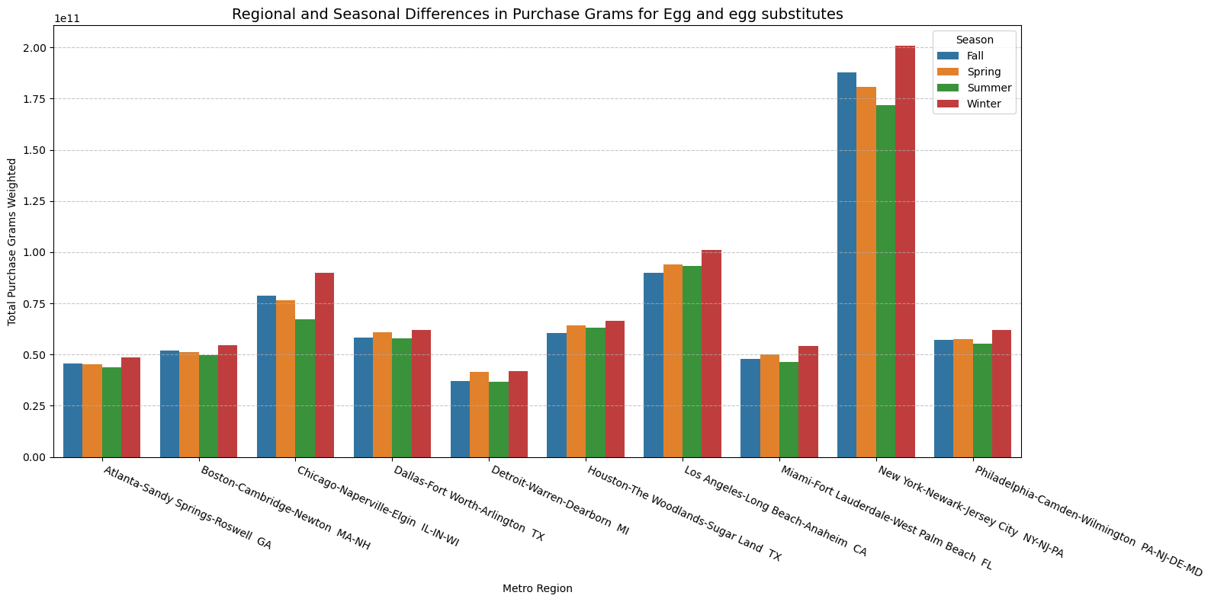
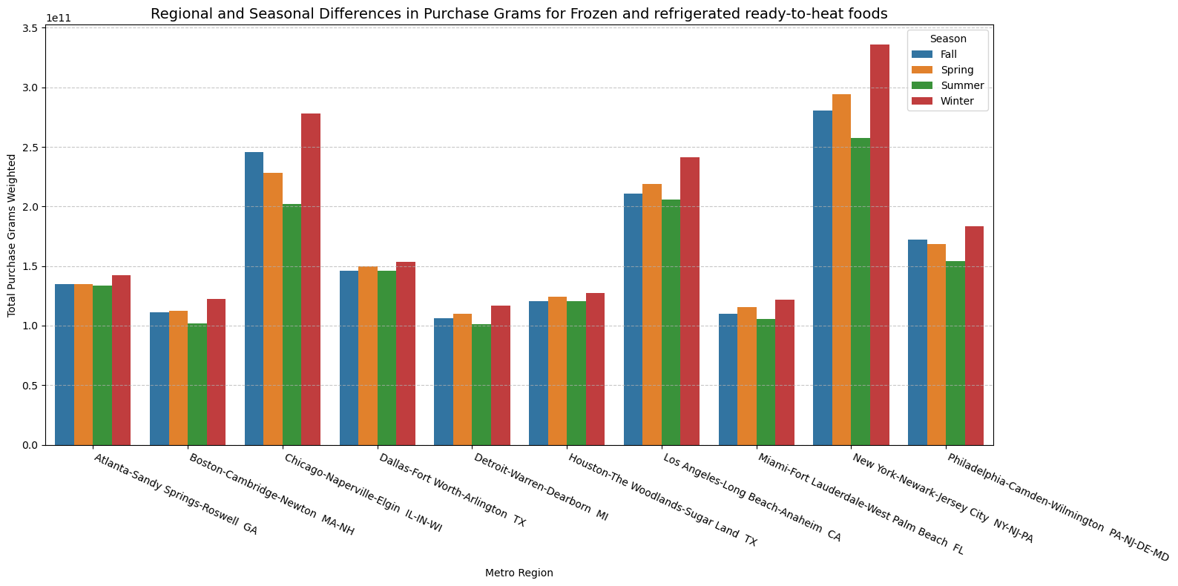
Eggs and Egg Substitutes:
Peaks in Spring and Fall, apart from winter correlating with holiday cooking and baking activities.
Frozen and Refrigerated Ready-to-Heat Foods:
Increased demand for convenient meal options during colder months.

Slide 22
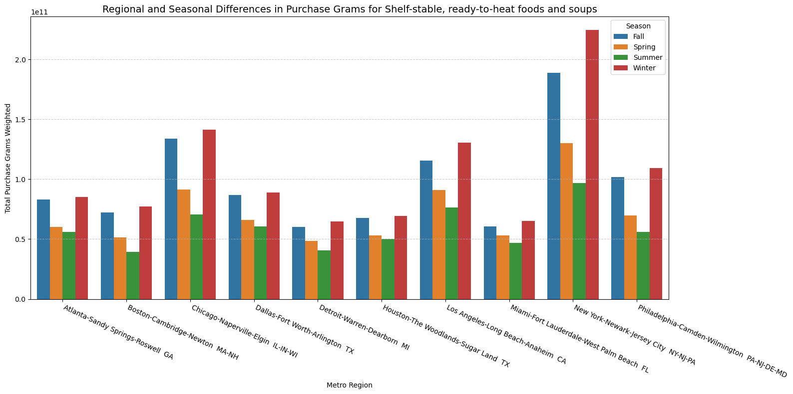
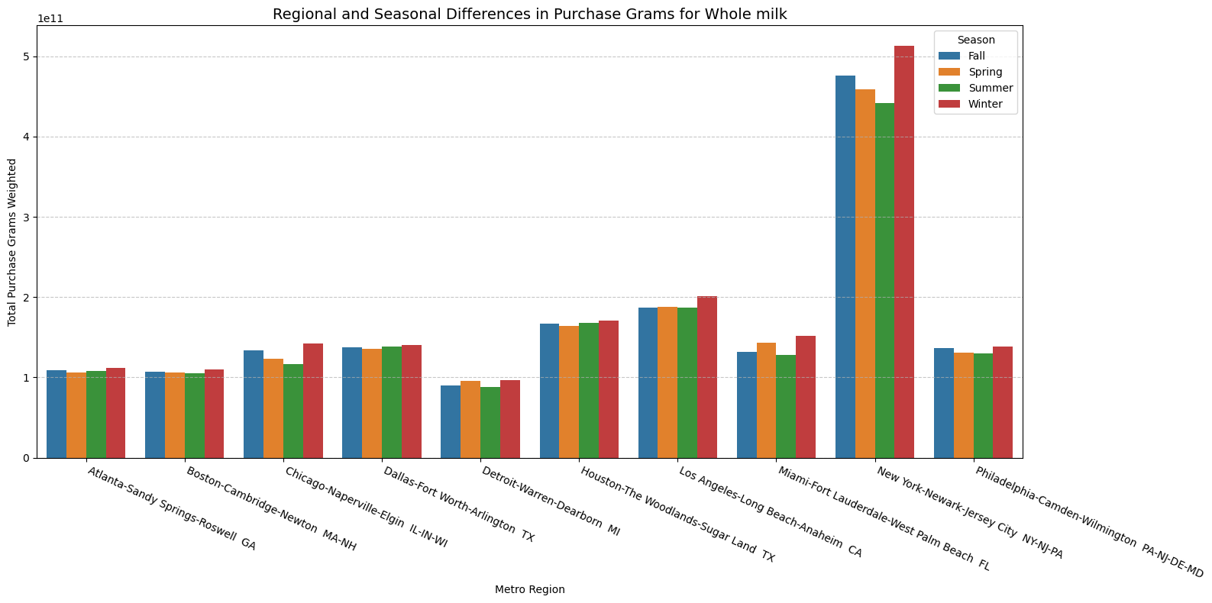
Shelf-Stable, Ready-to-Heat Foods and Soups:
Strong Winter demand, with lower levels during warmer seasons.
Cold weather drives increased soup consumption and shelf-stable meal options.
Whole Milk:
Noticeable Winter peaks, consistent demand throughout other seasons.
High demand in Winter suggests usage in hot beverages, increased cooking, and baking at home

Slide 23

MODELLING

Slide 24
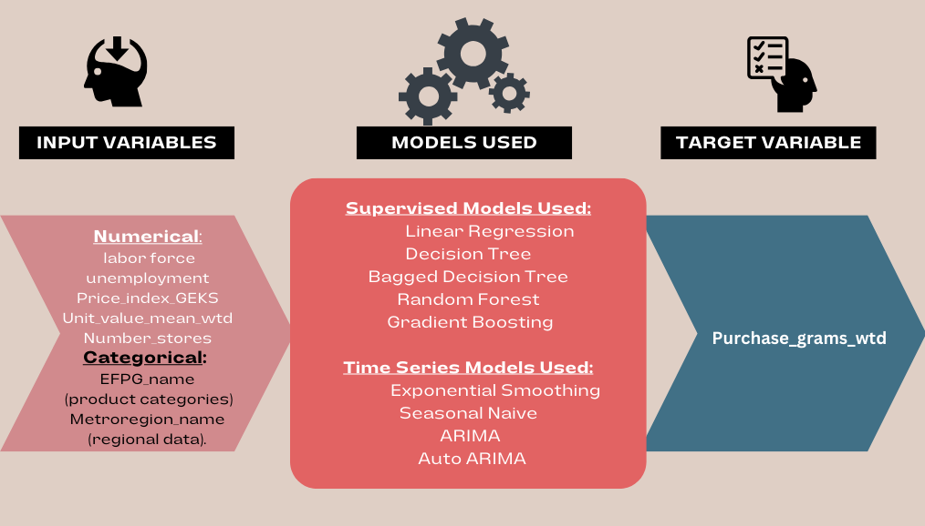
DEMAND PREDICTION AND FORECASTING
Objective:
Predict and forecast Purchase_grams_wtd to enable dynamic pricing and inventory optimization across product categories and regions.
Supervised Models are used for Demand prediction.
Time Series Models are used for Demand forecasting.
One-hot encoding was applied to categorical columns such as EFPG_name (product categories) and Metroregion_name (cities name) to enable seamless integration with machine learning models.

Slide 25
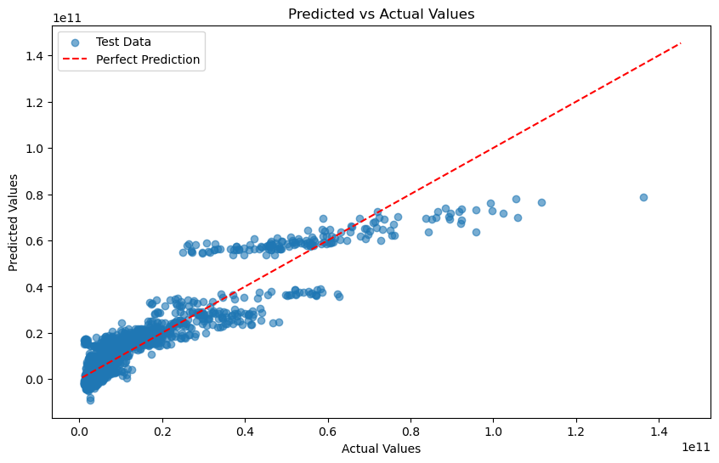
Modelling
Linear Regressor:
The model captures basic linear relationships but struggles with non-linear interactions.
Moderate generalization with a small performance drop from training to testing.
Limitations:
Does not account for complex feature interactions and categorical effects effectively.
Serves as a benchmark for comparing advanced models.
Linear Regression highlights the need for advanced techniques to handle non-linear and categorical patterns in the dataset.
Model Performance:
Training: R² = 0.86
Testing: R² = 0.84

Slide 26
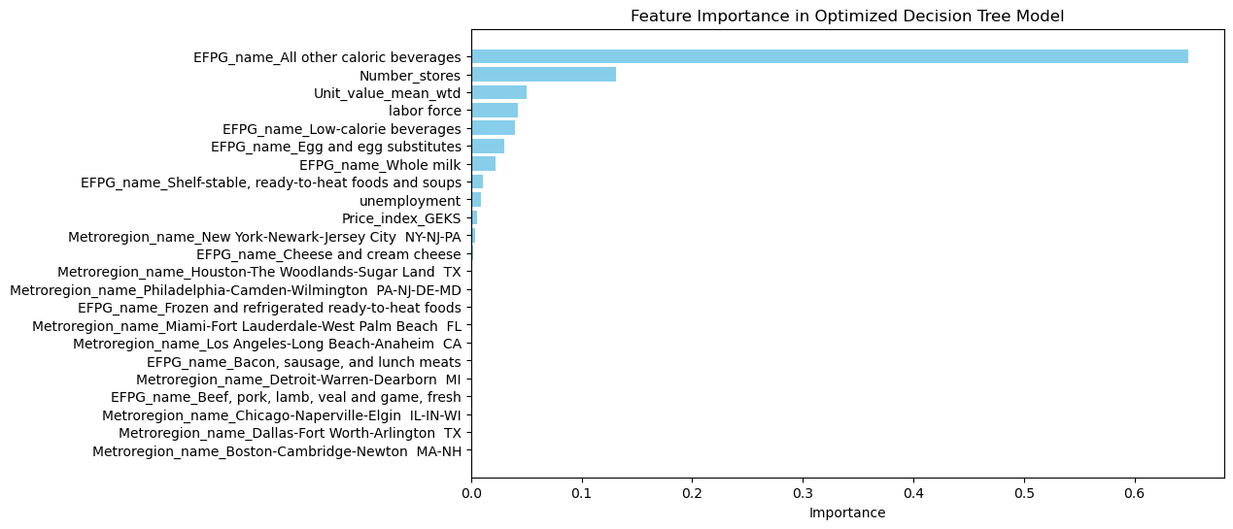
Modelling
Decision Tree Regressor:
EFPG_name All other caloric beverages contributes over 60%, highlighting high variability in demand for this category.
Number_stores and Labor force are key numerical contributors, emphasizing retail availability and economic activity.
Minimal overfitting, as evidenced by close training and testing R² scores.
Performance Summary:
Training: R²: 0.9920
Testing: R²: 0.9737
Conclusion:
Decision Tree serves as a baseline model, providing interpretable results and revealing significant feature contributions. Further enhancements using ensemble methods can improve robustness.

Slide 27
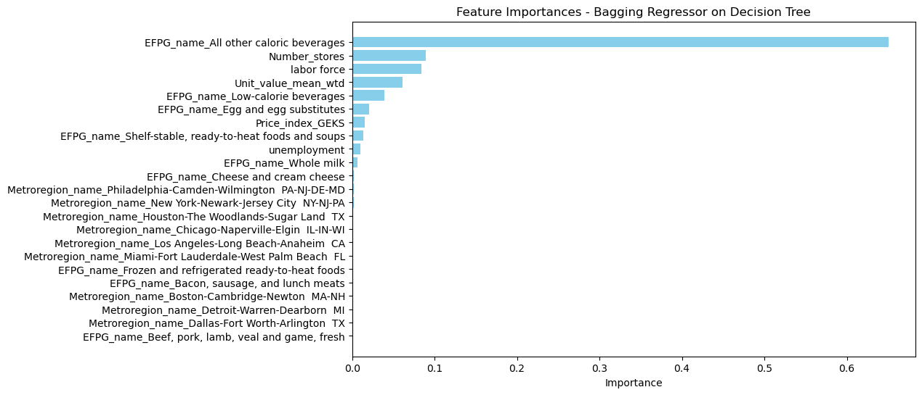
Modelling
Bagged Decision Tree Regressor:
The most impactful features remain consistent:
EFPG_name All other caloric beverages contributes the highest weight.
Number_stores and Labor force remain critical, reflecting the importance of retail and economic factors.
Key Improvements:
The testing R² improved , indicating better generalization to unseen data.
Training and testing scores are closer in the Bagging Regressor compared to the Decision Tree.
Bagging successfully enhances the Decision Tree’s generalization ability while maintaining high predictive power.
Model Performance:
Training: R² = 0.9914
Testing: R² = 0.9806

Slide 28
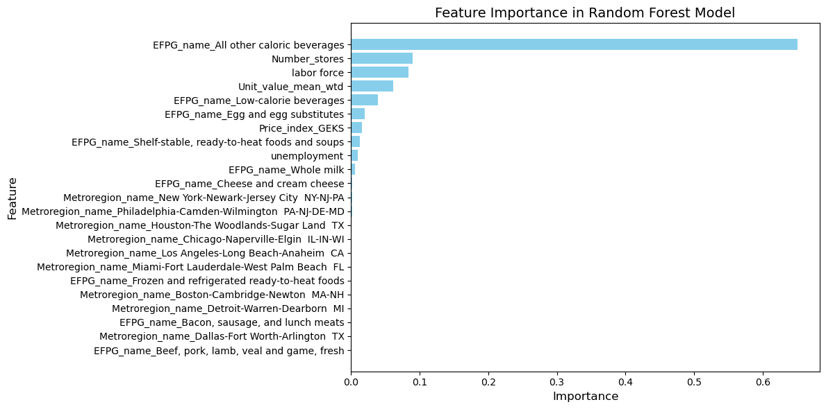
Modelling
Random Forest Regressor:
Testing R²: Marginal improvement (0.9806 in Bagging vs. 0.981 in Random Forest).
Slightly lower training error compared to Bagging due to better feature randomization and decorrelation.
Feature Importance:
EFPG_name All other caloric beverages is the most influential feature.
Number_stores, Labor force, and Unit_value_mean_wtd also significantly contribute to predictions.
Random Forest out-performed the Bagging Regressor slightly in generalization and accuracy.
Performance Metrics:
Training : R²: 0.991
Testing : R²: 0.9814

Slide 29
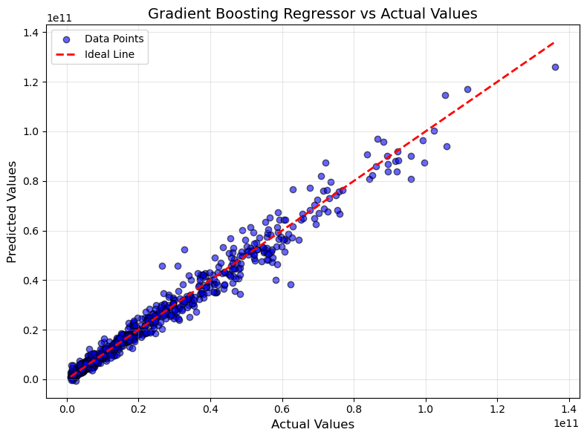
Modelling
Gradient Boosting Regressor:
Performance Metrics and Improvements:
Pre-Tuning R²:
Training: 0.960 (underfitting due to default parameters).
Testing: 0.940 (indicated moderate generalization issues).
Post-Tuning R²:
Training: 0.993 (significant improvement with better learning rate and depth control).
Testing: 0.9807 (excellent generalization achieved).
Fine-tuning hyperparameters helped balance bias and variance, improving model robustness.
Gradient Boosting achieved near-parity with Random Forest in terms of generalization, demonstrating its capability to capture complex patterns efficiently.

Slide 30
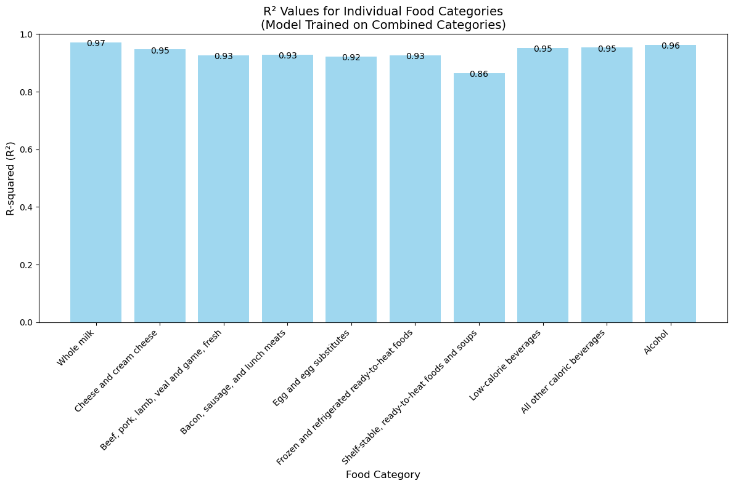
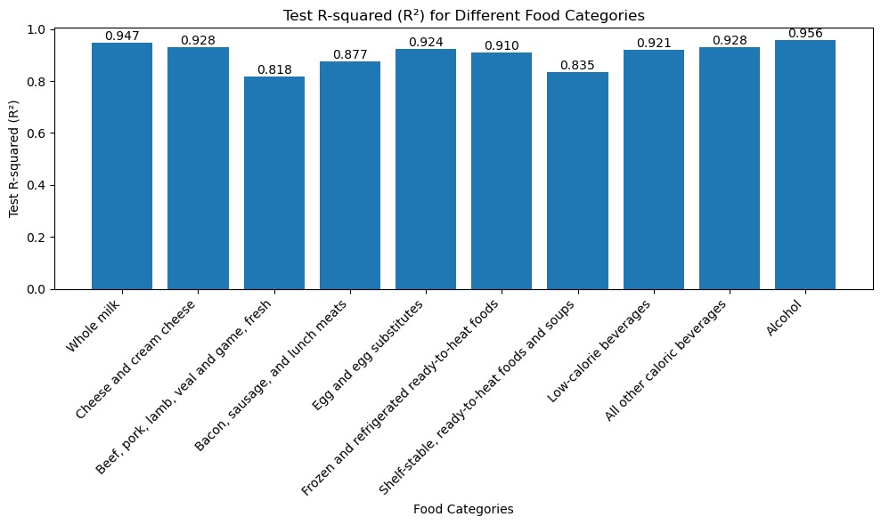
Model Performance Across Food Categories
The model trained on all 10 EFPG categories achieved higher R² scores when tested on individual categories, showcasing strong generalization across diverse food types.
The model trained on each individual EFPG category resulted in slightly lower R² scores, as it focuses solely on category-specific patterns without leveraging cross-category interactions.

Slide 31
MODEL PERFORMANCE METRICS
Machine learning Model Used | MSE |  | MAE |  | R-square
 | Train | Test | Train | Test | Train | Test
Linear Regressor | 5.72 × 10¹⁹ | 4.96 × 10¹⁹ | 5.03 × 10⁹ | 4.82 × 10⁹ | 0.86 | 0.84
Decision Tree Regressor | 3.20 × 10¹⁸ | 8.39 × 10¹⁸ | 833,497,890 | 1,381,366,798 | 0.9920 | 0.9737
Bagged Decision Tree Regressor | 3.46 × 10¹⁸ | 6.18 × 10¹⁸ | 882,559,525 | 1,210,872,591 | 0.9914 | 0.9806
Random Forest Regressor | 3.45 × 10¹⁸ | 6.17 × 10¹⁸ | 882,305,350 | 1,210,537,842 | 0.991 | 0.9814
Gradient Boosting Regressor | 1.7 × 10¹⁹ (Pre-Tuning) 2.73x10¹⁸ (Post-Tuning) | 2.02 × 10¹⁹ (Pre-Tuning) 6.13x10¹⁸ (Post-Tuning) | 2.4 × 10⁹ (Pre-Tuning) 0.97 × 10⁹ (Pre-Tuning) | 2.5 × 10⁹ (Pre-Tuning) 1.3 × 10⁹ (Post-Tuning) | 0.96 (Pre-Tuning) 0.993 (Post-Tuning) | 0.94 (Pre-Tuning) 0.9807 (Post-Tuning)

Slide 32
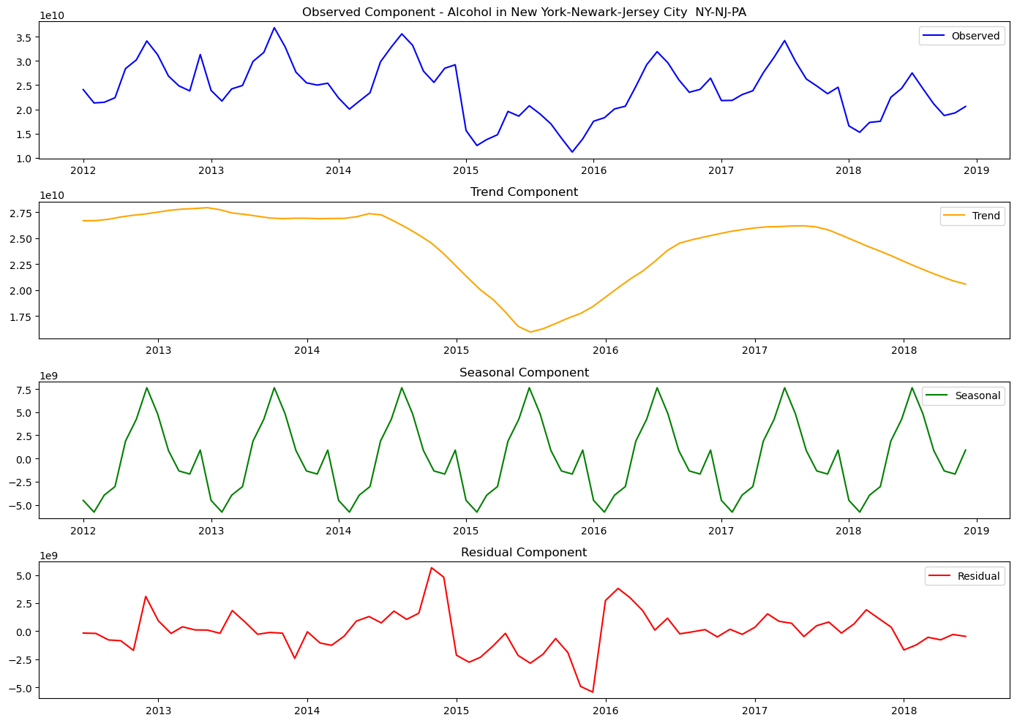
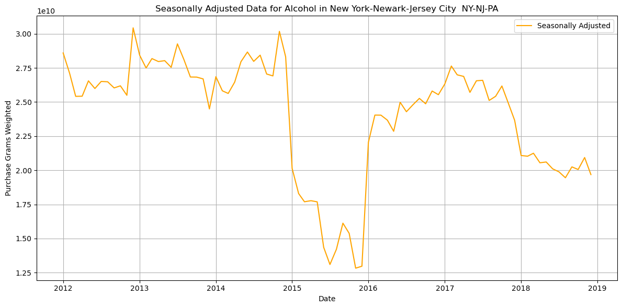
SEASONAL DECOMPOSITION

Slide 33
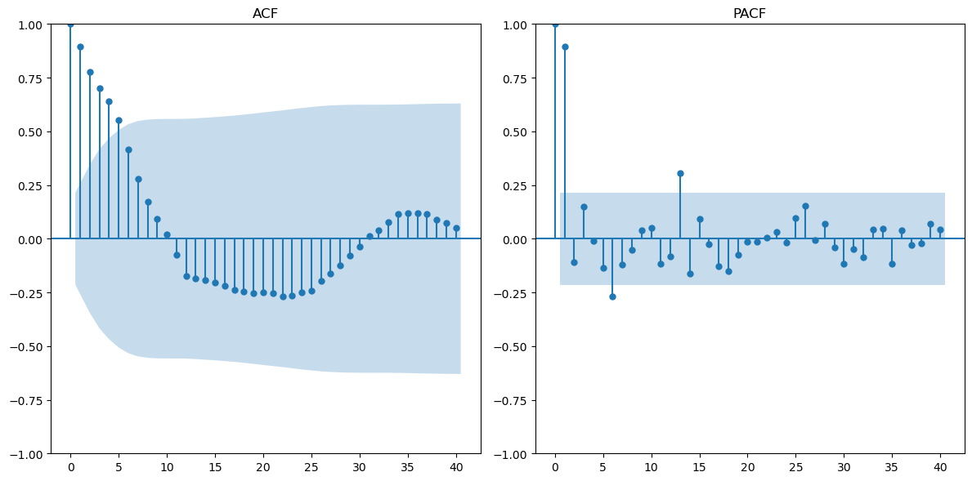
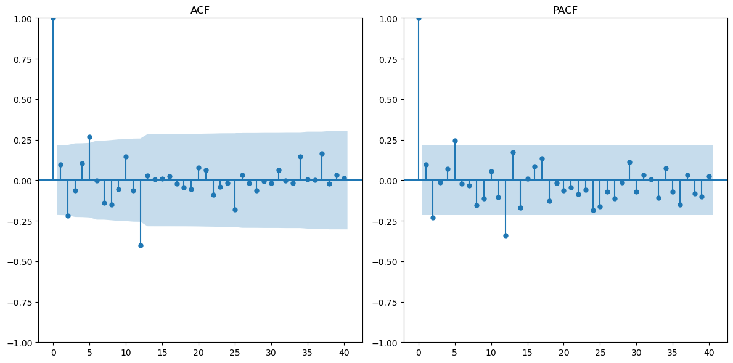
ARIMA ON SEASONALLY ADJUSTED DATA 'Alcohol in New York-Newark-Jersey City NY-NJ-PA'
Augmented Dickey-Fuller Test :
ADF Statistic: -2.4724
p-value: 0.1223
seasonally adjusted data is non-stationary (fail to reject null hypothesis)
Augmented Dickey-Fuller Test Results:
ADF Statistic: -7.5889
p-value: 0.00001
Differenced seasonally adjusted data is stationary (reject null hypothesis))
TIME LAGS
TIME LAGS
TIME LAGS
TIME LAGS
d=1 since stationary after first differencing p=2 and q=2
2 significant spikes in ACF and PACF before becoming insignificant

Slide 34
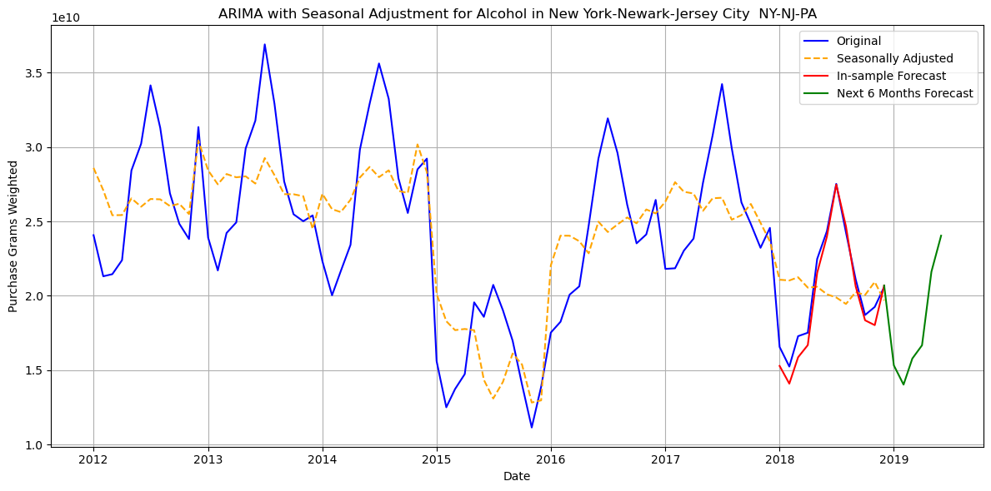
ARIMA ON SEASONALLY ADJUSTED DATA. 'Alcohol in New York-Newark-Jersey City NY-NJ-PA'
ARIMA(p=2,d=1,q=2)
Mean Absolute Error (MAE): 714760420.93
Root Mean Squared Error (RMSE): 850405217.16
Akaike Information Criterion (AIC): 3780.11
ARIMA(p=2,d=1,q=1)
Mean Absolute Error (MAE): 736843676.90
Root Mean Squared Error (RMSE): 892594857.30
Akaike Information Criterion (AIC): 3782.91
ARIMA(p=1,d=1,q=2)
Mean Absolute Error (MAE): 741106115.86
Root Mean Squared Error (RMSE): 897683318.38
Akaike Information Criterion (AIC): 3783.36
ARIMA(p=2,d=1,q=2)

Slide 35
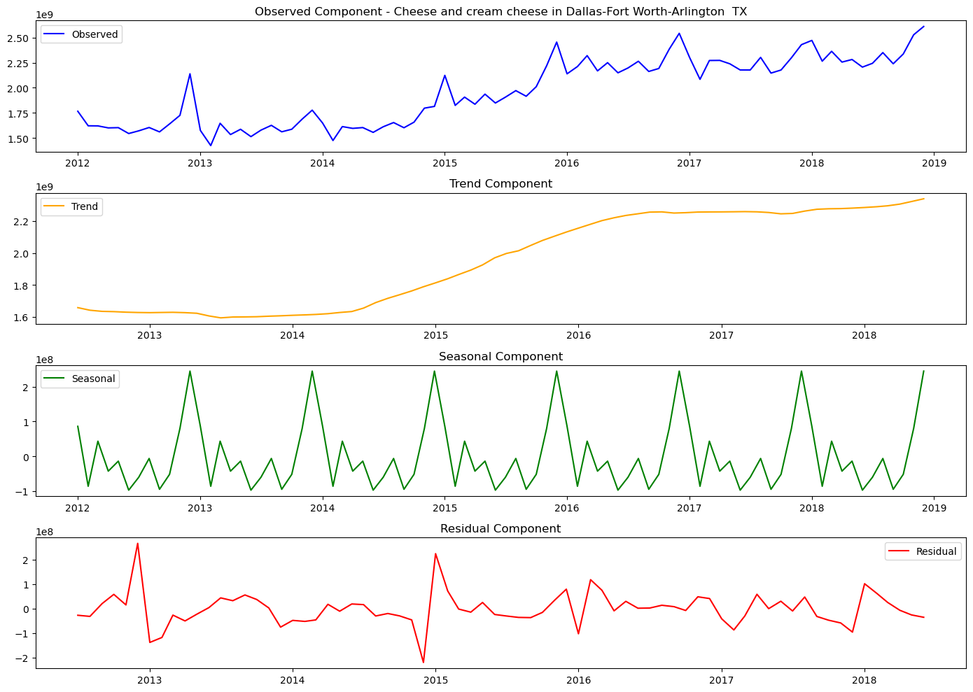
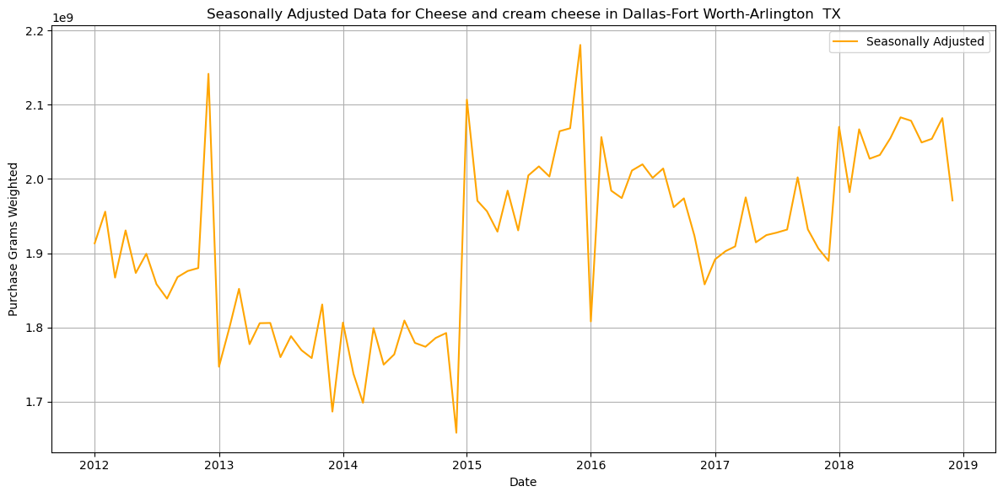
ARIMA ON SEASONALLY ADJUSTED DATA 'Cheese and cream cheese in Dallas-Fort Worth-Arlington TX'

Slide 36
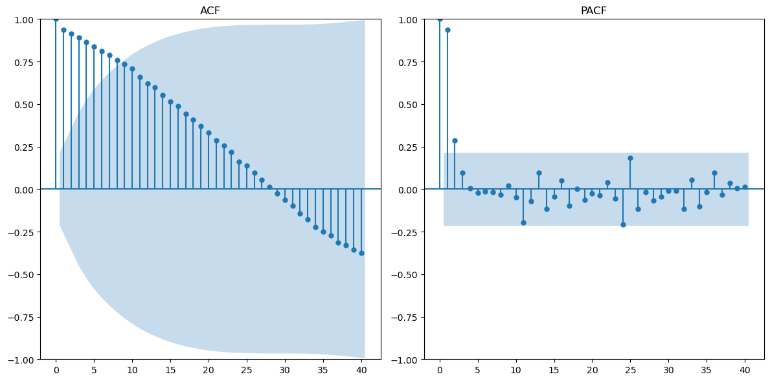
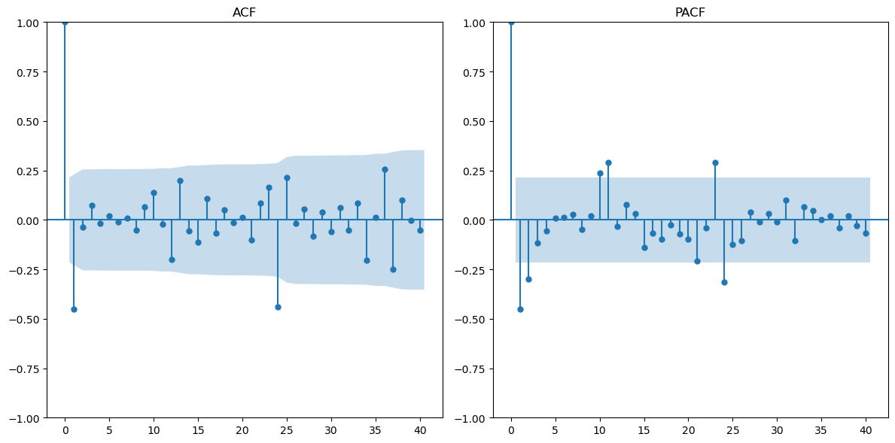
ARIMA ON SEASONALLY ADJUSTED DATA 'Cheese and cream cheese in Dallas-Fort Worth-Arlington TX'
Augmented Dickey-Fuller Test :
ADF Statistic: -0.2797
p-value: 0.9283
seasonally adjusted data is non-stationary (fail to reject null hypothesis)
Augmented Dickey-Fuller Test :
ADF Statistic: -10.3946
p-value: 0.00001
Differenced seasonally adjusted data is stationary (reject null hypothesis)
TIME LAGS
TIME LAGS
TIME LAGS
TIME LAGS
d=1 since stationary after first differencing p=1 and q=1 .
1 significant spike in ACF and PACF before becoming insignificant

Slide 37
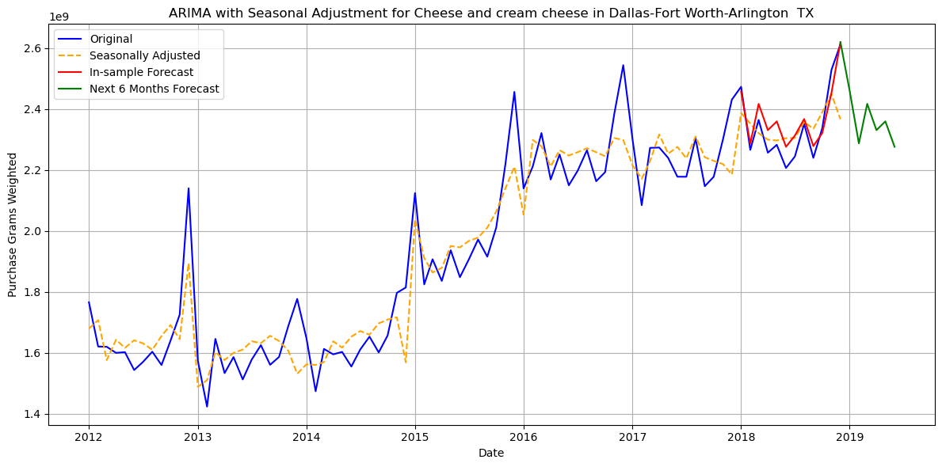
ARIMA ON SEASONALLY ADJUSTED DATA 'Cheese and cream cheese in Dallas-Fort Worth-Arlington TX'
ARIMA(p=1,d=1,q=1)
Mean Absolute Error (MAE): 44192143.87
Root Mean Squared Error (RMSE): 51678536.80
Akaike Information Criterion (AIC): 3290.16
ARIMA(p=1,d=1,q=1)

Slide 38
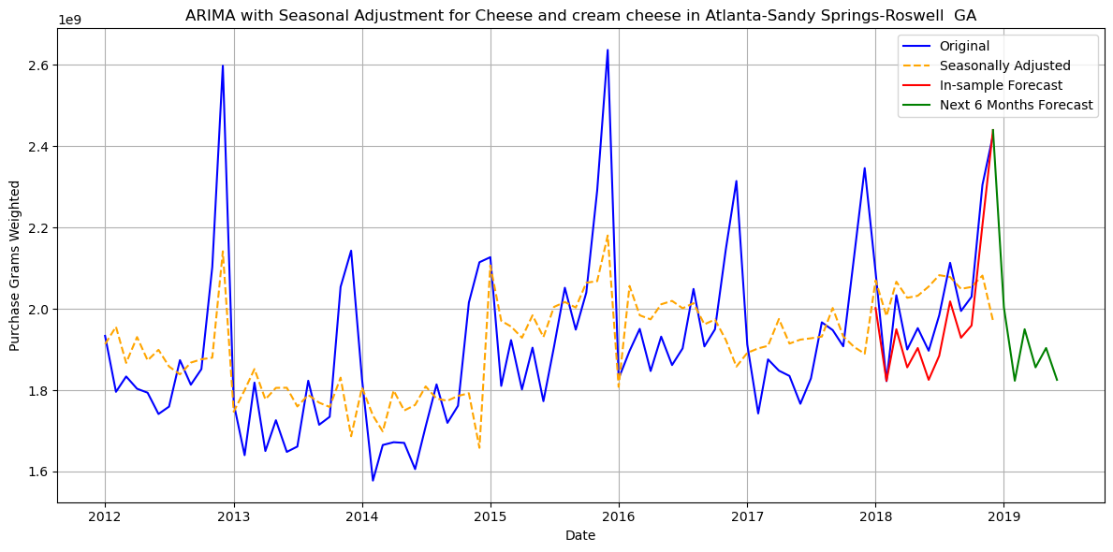
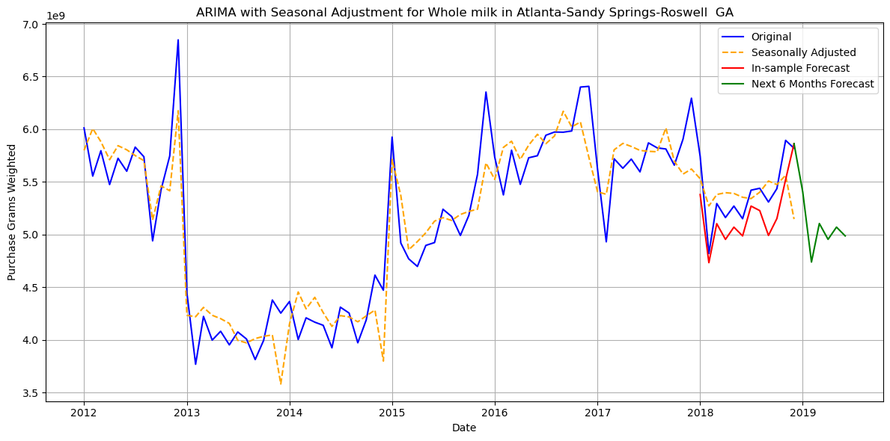
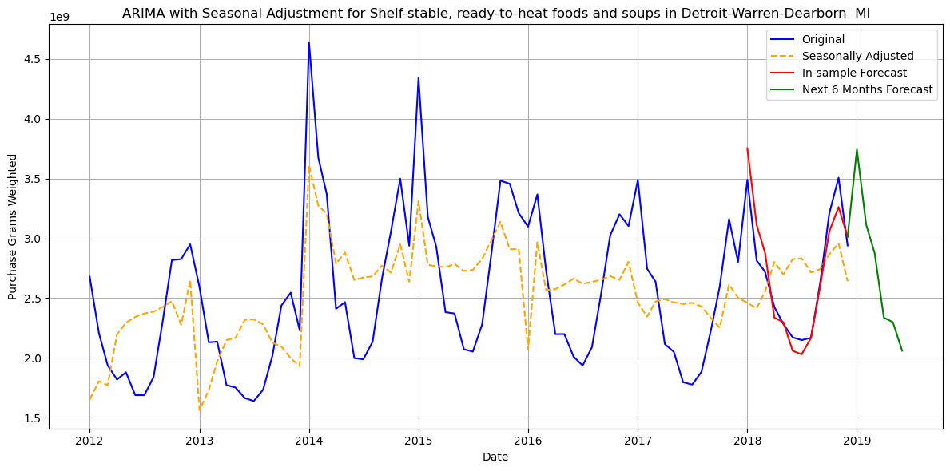
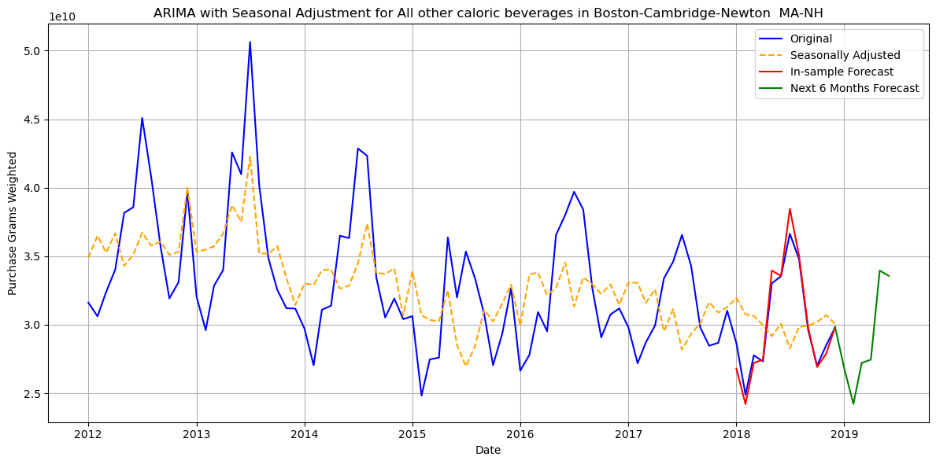
ARIMA ON SEASONALLY ADJUSTED DATA

Slide 39
TIME SERIES MODELS
Exponential Smoothing (ETS)
Seasonal Naive
Auto ARIMA
Captures error, trend, and seasonality components. Uses weighted averages of past data, with more weight on recent observations. Additive trend and seasonality were used in our model. Suitable for series with fixed seasonal patterns and consistent trends. No stationarity requirement.
Forecasts are based on the most recent seasonal values. Assumes that patterns repeat exactly across seasons. Simple and effective for data with strong, consistent seasonality. Used as a baseline model.
Automatically selects the best p, d, q, P, D, Q, m parameters. Combines autoregressive, differencing, and moving average terms. Optimizes based on criteria like AIC. Requires stationarity and handles internally through differencing.

Slide 40
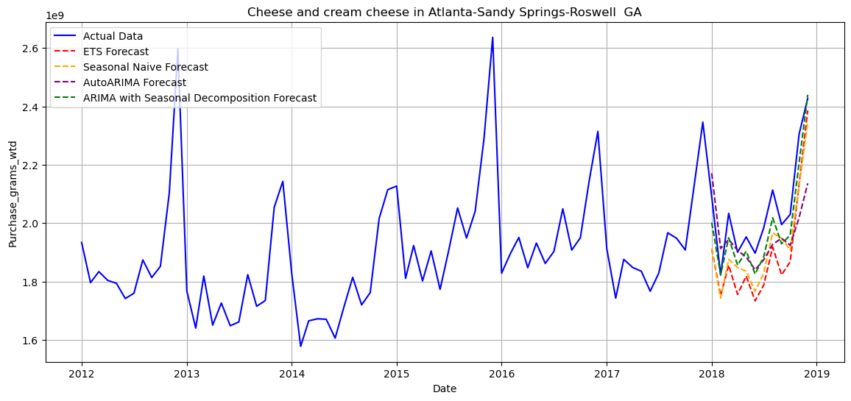
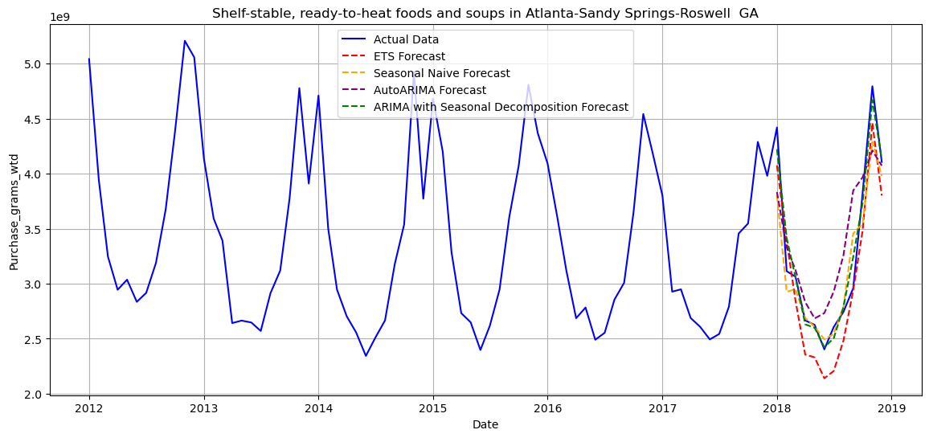
TIME SERIES MODELS

Slide 41
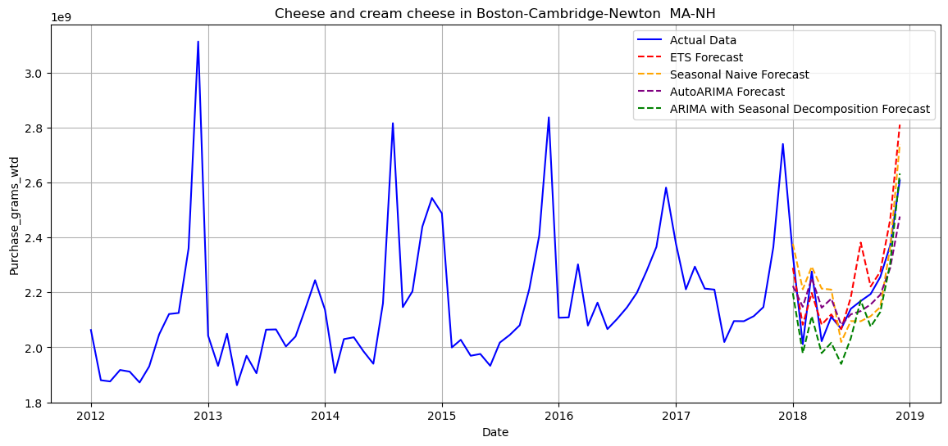
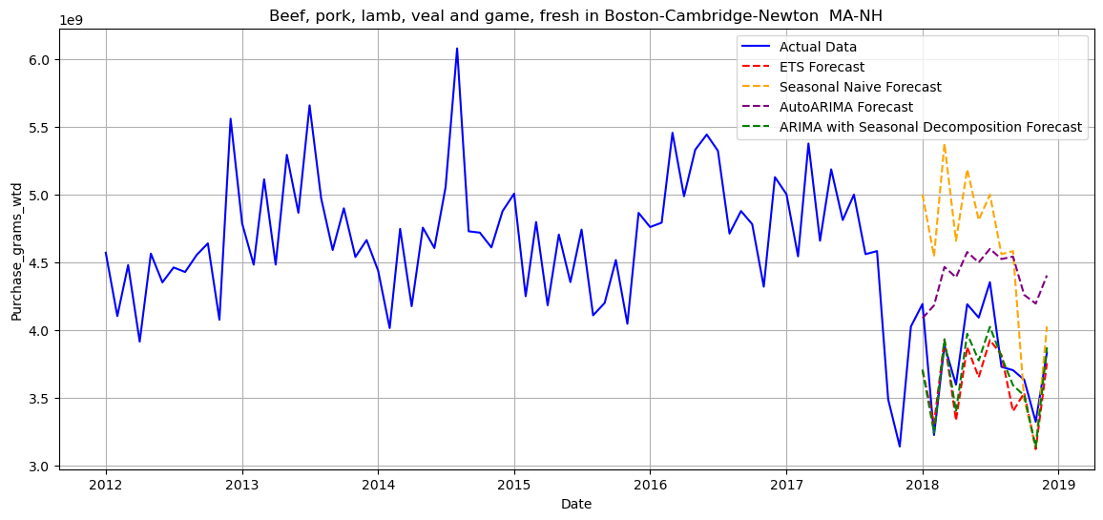
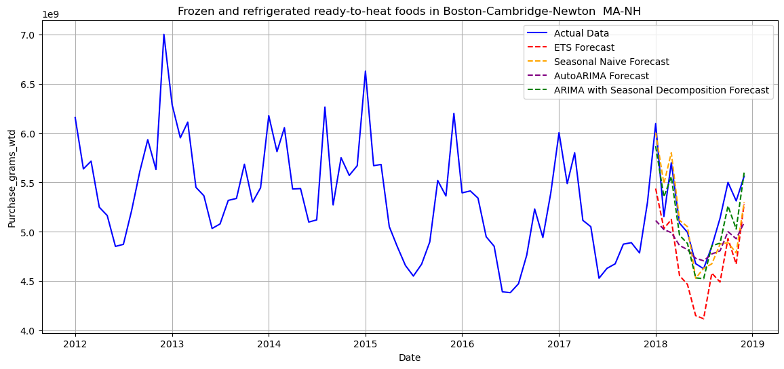
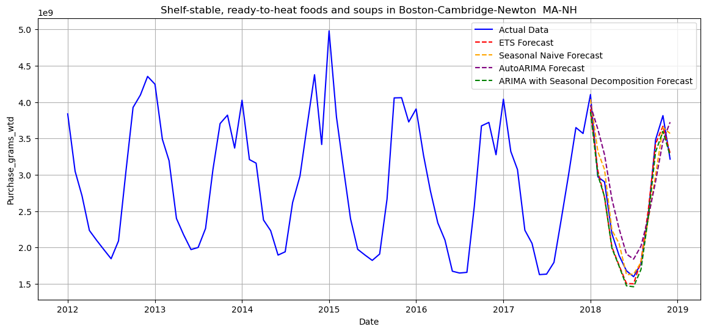
TIME SERIES MODELS

Slide 42
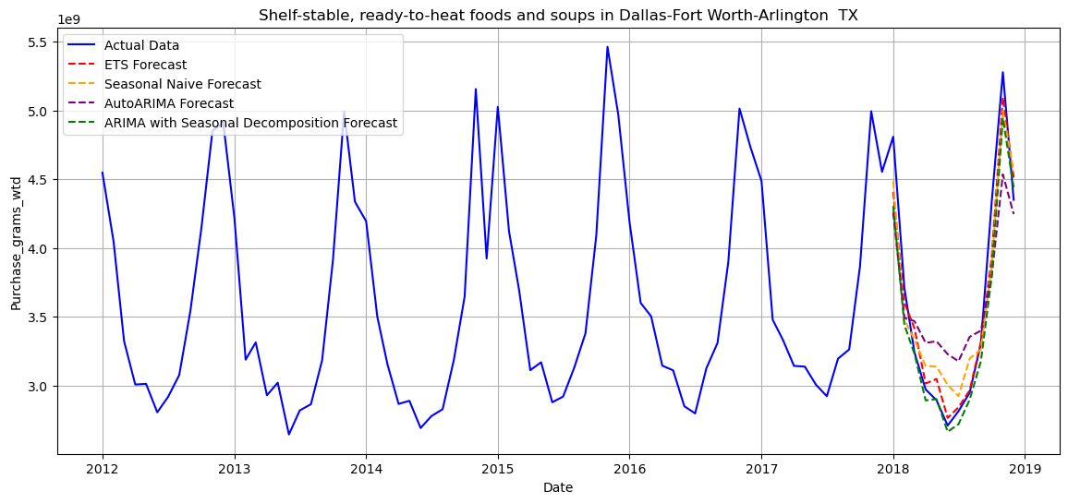
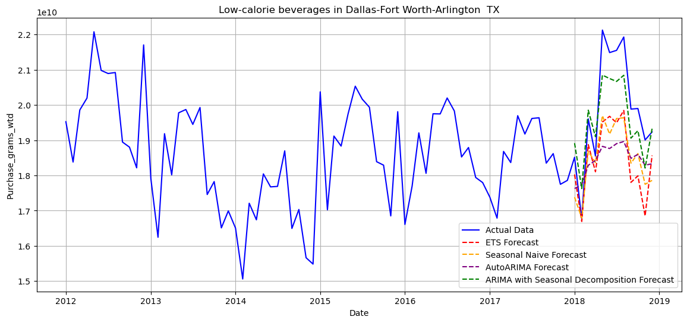
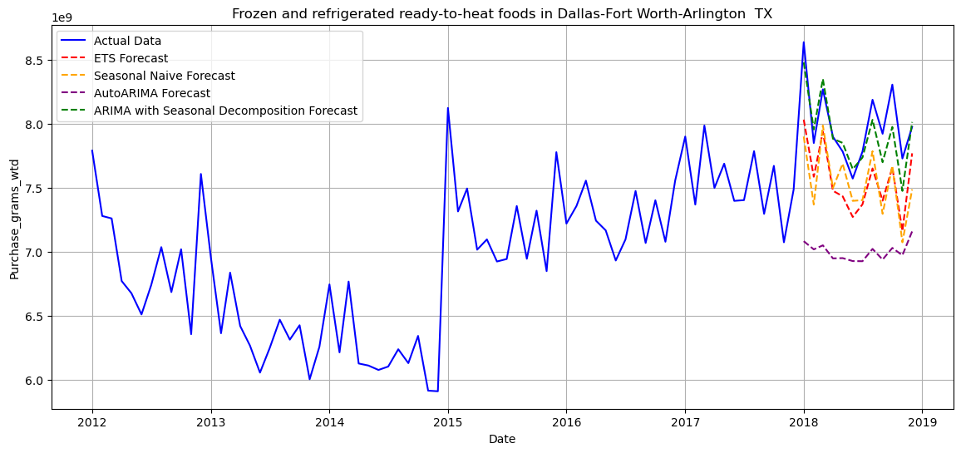
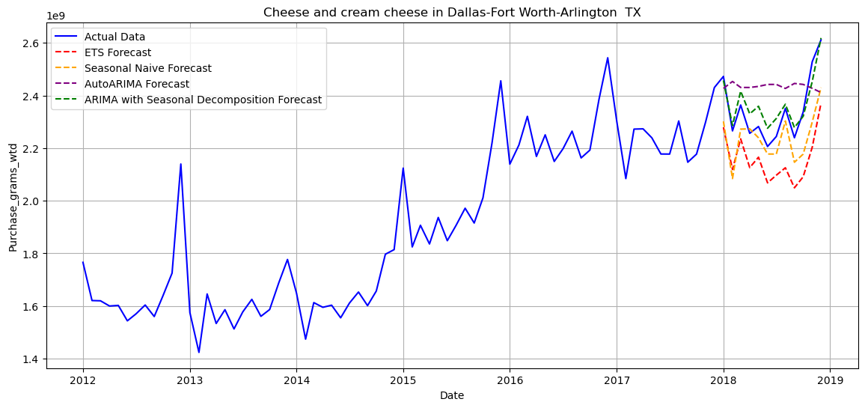
TIME SERIES MODELS

Slide 43

EVALUATION

Slide 44
TIME SERIES MODELS
Atlanta-Sandy Springs-Roswell GA
Food Category | Metrics | ETS | Seasonal NAÏVE | AutoArima | ARIMA with seasonal decomposition(ARIMA) | Best Fitted Model
Whole milk | MAE | 276063200 | 338545600 | 867793000 | 214595400 | ARIMA
 | RMSE | 318629000 | 376466800 | 916171900 | 234979800
Cheese and cream cheese | MAE | 150695500 | 120248200 | 118245500 | 64944410 | ARIMA
 | RMSE | 157590600 | 127988100 | 146527500 | 72113870
Beef, pork, lamb, veal and game, fresh | MAE | 327426800 | 334804300 | 197141400 | 157842900 | ARIMA
 | RMSE | 355756800 | 373832700 | 271811600 | 181905900
Bacon, sausage, and lunch meats | MAE | 140554200 | 207077400 | 204948200 | 119543000 | ARIMA
 | RMSE | 173550200 | 275434800 | 282860100 | 140432600
Egg and egg substitutes | MAE | 111401200 | 88571660 | 173459700 | 62792690 | ARIMA
 | RMSE | 130983800 | 123968600 | 212199500 | 72723610
Frozen and refrigerated ready-to-heat foods | MAE | 194257700 | 330023400 | 141707100 | 172543100 | ARIMA
 | RMSE | 200251400 | 372263200 | 201724600 | 182729200
Shelf-stable, ready-to-heat foods and soups | MAE | 280411700 | 213899500 | 325384800 | 104393200 | ARIMA
 | RMSE | 294907100 | 294478800 | 413874600 | 144132100
Low-calorie beverages | MAE | 1603896000 | 1126428000 | 2785095000 | 729488500 | ARIMA
 | RMSE | 1722157000 | 1205606000 | 3050707000 | 870281700
All other caloric beverages | MAE | 1435685000 | 2249436000 | 3388845000 | 1958266000 | Seasonal Naïve
 | RMSE | 1740322000 | 1336148000 | 3729654000 | 2281526000
Alcohol | MAE | 830533900 | 439596900 | 1395806000 | 627634600 | Seasonal Naïve
 | RMSE | 1017117000 | 589101000 | 1794030000 | 752998400

Slide 45
TIME SERIES MODELS
Boston-Cambridge-Newton MA-NH
Food Category | Metrics | ETS | Seasonal NAÏVE | AutoArima | ARIMA with seasonal decomposition(ARIMA) | Best Fitted Model
Whole milk | MAE | 628696700 | 345122600 | 647236000 | 97512150 | ARIMA
 | RMSE | 660415500 | 438324200 | 697164400 | 141109000
Cheese and cream cheese | MAE | 72054260 | 87015890 | 70616900 | 87196760 | AutoARIMA
 | RMSE | 97930290 | 105696800 | 82957880 | 100366500
Beef, pork, lamb, veal and game, fresh | MAE | 235919800 | 772959400 | 597881800 | 178125200 | ARIMA
 | RMSE | 281146600 | 877102800 | 650620800 | 223726900
Bacon, sausage, and lunch meats | MAE | 117468700 | 460341400 | 494593600 | 137204600 | ETS
 | RMSE | 152137900 | 577821400 | 529718600 | 152932000
Egg and egg substitutes | MAE | 267072100 | 236640200 | 135130900 | 96515970 | ARIMA
 | RMSE | 293953700 | 302253800 | 167790400 | 109606200
Frozen and refrigerated ready-to-heat foods | MAE | 487749300 | 216829800 | 342966200 | 155395700 | ARIMA
 | RMSE | 514359800 | 285070700 | 437945700 | 176271400
Shelf-stable, ready-to-heat foods and soups | MAE | 122921400 | 164429200 | 350728900 | 141943200 | ETS
 | RMSE | 136221900 | 220073000 | 391312500 | 159848300
Low-calorie beverages | MAE | 1309033000 | 988721500 | 1157397000 | 375411100 | ARIMA
 | RMSE | 1411091000 | 1210890000 | 1598920000 | 492025200
All other caloric beverages | MAE | 1064780000 | 1004429000 | 2196131000 | 598781900 | ARIMA
 | RMSE | 1451174000 | 1275231000 | 2602552000 | 863237800
Alcohol | MAE | 2609444000 | 2220882000 | 2314391000 | 722903300 | ARIMA
 | RMSE | 2637458000 | 1883923000 | 2462729000 | 789583900

Slide 46
TIME SERIES MODELS
Chicago-Naperville-Elgin IL-IN-WI
Food Category | Metrics | ETS | Seasonal NAÏVE | AutoArima | ARIMA with seasonal decomposition(ARIMA) | Best Fitted Model
Whole milk | MAE | 2824865000 | 1750721000 | 1100656000 | 1046163000 | Seasonal Naïve
 | RMSE | 2957585000 | 950484400 | 1161781000 | 1261506000
Cheese and cream cheese | MAE | 2029728000 | 622481700 | 163672200 | 1427814000 | AutoARIMA
 | RMSE | 2177871000 | 667314900 | 200113100 | 1524534000
Beef, pork, lamb, veal and game, fresh | MAE | 694498900 | 2701536000 | 1483907000 | 1360231000 | ETS
 | RMSE | 1036634000 | 2902538000 | 1523129000 | 1465051000
Bacon, sausage, and lunch meats | MAE | 1502108000 | 2171674000 | 1459735000 | 1903780000 | Seasonal Naïve
 | RMSE | 1635760000 | 598418200 | 1808465000 | 2048234000
Egg and egg substitutes | MAE | 1683513000 | 943722200 | 258680000 | 1159769000 | AutoARIMA
 | RMSE | 1827913000 | 1298752000 | 333297700 | 1284251000
Frozen and refrigerated ready-to-heat foods | MAE | 3912017000 | 2091351000 | 488542500 | 2894127000 | AutoARIMA
 | RMSE | 4207658000 | 1108288000 | 565726600 | 3110008000
Shelf-stable, ready-to-heat foods and soups | MAE | 2078855000 | 1329817000 | 954319400 | 2019889000 | AutoARIMA
 | RMSE | 2230021000 | 1294532000 | 1048130000 | 2151665000
Low-calorie beverages | MAE | 14306040000 | 5311222000 | 2981747000 | 9385678000 | AutoARIMA
 | RMSE | 15029270000 | 7361328000 | 3238139000 | 10183960000
All other caloric beverages | MAE | 9274774000 | 18828330000 | 11233170000 | 13014180000 | Seasonal Naïve
 | RMSE | 10375120000 | 1329255000 | 13665470000 | 14390060000
Alcohol | MAE | 11113220000 | 2523796000 | 2458240000 | 8622482000 | Seasonal Naïve
 | RMSE | 12225620000 | 761111700 | 2964657000 | 9394419000

Slide 47
TIME SERIES MODELS
Dallas-Fort Worth-Arlington TX
Food Category | Metrics | ETS | Seasonal NAÏVE | AutoArima | ARIMA with seasonal decomposition(ARIMA) | Best Fitted Model
Whole milk | MAE | 1200230000 | 930970700 | 889055200 | 403480200 | ARIMA
 | RMSE | 1212513000 | 956160400 | 909639800 | 431686100
Cheese and cream cheese | MAE | 185628800 | 109169600 | 145745900 | 44192140 | ARIMA
 | RMSE | 195261600 | 129012800 | 158067400 | 51678540
Beef, pork, lamb, veal and game, fresh | MAE | 187230400 | 279643400 | 372136000 | 213833100 | ETS
 | RMSE | 213351200 | 327401300 | 463317000 | 257501400
Bacon, sausage, and lunch meats | MAE | 142910700 | 225775300 | 635003800 | 146760500 | ARIMA
 | RMSE | 202591100 | 281535900 | 687059700 | 195856100
Egg and egg substitutes | MAE | 229334300 | 321401100 | 244146300 | 172503800 | ARIMA
 | RMSE | 266719400 | 405943200 | 285962200 | 202045100
Frozen and refrigerated ready-to-heat foods | MAE | 429624700 | 445591500 | 988955400 | 128855000 | ARIMA
 | RMSE | 451051800 | 484160500 | 1020285000 | 158870500
Shelf-stable, ready-to-heat foods and soups | MAE | 144763200 | 225642100 | 377409500 | 179151900 | ETS
 | RMSE | 194562700 | 250928300 | 420872900 | 253957500
Low-calorie beverages | MAE | 1426358000 | 1390829000 | 1605600000 | 699066000 | ARIMA
 | RMSE | 1651678000 | 1578701000 | 1884489000 | 770826100
All other caloric beverages | MAE | 9320443000 | 8395301000 | 6825083000 | 1610927000 | ARIMA
 | RMSE | 9597360000 | 9695204000 | 7425160000 | 2172932000
Alcohol | MAE | 10406000000 | 8556801000 | 5711695000 | 2447514000 | ARIMA
 | RMSE | 10490490000 | 10608611000 | 6867665000 | 2732866000

Slide 48
TIME SERIES MODELS
Detroit-Warren-Dearborn MI
Food Category | Metrics | ETS | Seasonal NAÏVE | AutoArima | ARIMA with seasonal decomposition (ARIMA) | Best Fitted Model
Whole milk | MAE | 411499300 | 659029400 | 612585100 | 272744200 | ARIMA
 | RMSE | 482592600 | 700128900 | 622431500 | 351585200
Cheese and cream cheese | MAE | 210950300 | 214686600 | 86749730 | 68455640 | ARIMA
 | RMSE | 222599400 | 234340500 | 119875500 | 90356090
Beef, pork, lamb, veal and game, fresh | MAE | 184776200 | 253357800 | 286320400 | 179821200 | ARIMA
 | RMSE | 215433300 | 296895100 | 332612300 | 204133600
Bacon, sausage, and lunch meats | MAE | 279951500 | 430316800 | 252625200 | 214651100 | ARIMA
 | RMSE | 310276600 | 499984000 | 310908200 | 291018600
Egg and egg substitutes | MAE | 162187800 | 177217900 | 200327200 | 103369800 | ARIMA
 | RMSE | 202511700 | 187911400 | 216656300 | 115802000
Frozen and refrigerated ready-to-heat foods | MAE | 264843700 | 422638800 | 475511300 | 152536800 | ARIMA
 | RMSE | 306712900 | 447507500 | 555638300 | 183858500
Shelf-stable, ready-to-heat foods and soups | MAE | 272332700 | 269053800 | 295064000 | 129507900 | ARIMA
 | RMSE | 303481400 | 316163600 | 386944000 | 159854800
Low-calorie beverages | MAE | 2706311000 | 2027063000 | 1620598000 | 668657300 | ARIMA
 | RMSE | 2819978000 | 1832710000 | 1884172000 | 784798100
All other caloric beverages | MAE | 811245500 | 973201000 | 2333225000 | 1023074000 | Seasonal Naïve
 | RMSE | 986670800 | 642584400 | 2972161000 | 1171549000
Alcohol | MAE | 1648876000 | 2995825000 | 1308818000 | 819207600 | ARIMA
 | RMSE | 1917734000 | 1382736000 | 1701840000 | 926164100

Slide 49
TIME SERIES MODELS
Houston-The Woodlands-Sugar Land TX
Food Category | Metrics | ETS | Seasonal NAÏVE | AutoArima | ARIMA with seasonal decomposition(ARIMA) | Best Fitted Model
Whole milk | MAE | 1201494000 | 334272200 | 941394400 | 896365100 | Seasonal Naïve
 | RMSE | 1309204000 | 531688600 | 979731000 | 950670600
Cheese and cream cheese | MAE | 171834700 | 183349000 | 85393090 | 80301220 | ARIMA
 | RMSE | 179166300 | 190663600 | 115898600 | 89857420
Beef, pork, lamb, veal and game, fresh | MAE | 200250300 | 554067600 | 268745600 | 218802700 | ETS
 | RMSE | 257380600 | 642764400 | 383163700 | 286598100
Bacon, sausage, and lunch meats | MAE | 207346000 | 261773200 | 339618800 | 364103400 | ETS
 | RMSE | 267395900 | 308804200 | 412978800 | 404925400
Egg and egg substitutes | MAE | 394912700 | 402290800 | 412053500 | 379125200 | ETS
 | RMSE | 456130700 | 490457200 | 468802700 | 467471500
Frozen and refrigerated ready-to-heat foods | MAE | 154698100 | 185365200 | 192612500 | 237436100 | ETS
 | RMSE | 195300800 | 223356000 | 280686300 | 258158500
Shelf-stable, ready-to-heat foods and soups | MAE | 204778700 | 300519000 | 391351400 | 213050000 | ETS
 | RMSE | 232694200 | 448262000 | 470083800 | 237770000
Low-calorie beverages | MAE | 1746387000 | 1009545000 | 2043962000 | 866922100 | ARIMA
 | RMSE | 1888996000 | 1135797000 | 2292509000 | 984095200
All other caloric beverages | MAE | 5614253000 | 6663241000 | 5404759000 | 1902727000 | Seasonal Naïve
 | RMSE | 6142264000 | 580668300 | 6327505000 | 2482986000
Alcohol | MAE | 3335409000 | 3580709000 | 3604015000 | 901998400 | ARIMA
 | RMSE | 3523495000 | 1347546000 | 4528597000 | 992198200

Slide 50
TIME SERIES MODELS
Los Angeles-Long Beach-Anaheim CA
Food Category | Metrics | ETS | Seasonal NAÏVE | AutoArima | ARIMA with seasonal decomposition(ARIMA) | Best Fitted Model
Whole milk | MAE | 4079202000 | 2228513000 | 6594276000 | 2587731000 | Seasonal Naïve
 | RMSE | 4493229000 | 2317850000 | 7004499000 | 2939725000
Cheese and cream cheese | MAE | 772346400 | 112111300 | 882917000 | 1203346000 | Seasonal Naïve
 | RMSE | 838682000 | 153780800 | 1153082000 | 1268921000
Beef, pork, lamb, veal and game, fresh | MAE | 4403705000 | 1759340000 | 3166384000 | 5882847000 | Seasonal Naïve
 | RMSE | 4774904000 | 1872061000 | 3529969000 | 6289628000
Bacon, sausage, and lunch meats | MAE | 1537221000 | 687420500 | 1299368000 | 2270313000 | Seasonal Naïve
 | RMSE | 1740636000 | 849612500 | 1754603000 | 2397070000
Egg and egg substitutes | MAE | 722615200 | 914233200 | 688230400 | 2879358000 | ETS
 | RMSE | 1027328000 | 1118091000 | 1244874000 | 3062603000
Frozen and refrigerated ready-to-heat foods | MAE | 1266640000 | 428608800 | 1121036000 | 1744846000 | Seasonal Naïve
 | RMSE | 1345849000 | 552979400 | 1450103000 | 1888186000
Shelf-stable, ready-to-heat foods and soups | MAE | 778858300 | 350364700 | 847230900 | 628627200 | Seasonal Naïve
 | RMSE | 949054300 | 407023300 | 1128625000 | 722179500
Low-calorie beverages | MAE | 6170469000 | 1298193000 | 4516621000 | 4192109000 | Seasonal Naïve
 | RMSE | 6793252000 | 1166467000 | 4934963000 | 4507890000
All other caloric beverages | MAE | 27645150000 | 16811440000 | 8458248000 | 12305280000 | Seasonal Naïve
 | RMSE | 29881970000 | 1859193000 | 9846862000 | 14093380000
Alcohol | MAE | 5471376000 | 3327027000 | 4038117000 | 4670346000 | AutoARIMA
 | RMSE | 6219001000 | 3627068000 | 4896224000 | 5153773000

Slide 51
TIME SERIES MODELS
Miami-Fort Lauderdale-West Palm Beach FL
Food Category | Metrics | ETS | Seasonal NAÏVE | AutoArima | ARIMA with seasonal decomposition(ARIMA) | Best Fitted Model
Whole milk | MAE | 1070819000 | 1340191000 | 919800200 | 797336500 | Seasonal Naïve
 | RMSE | 1202174000 | 853098500 | 996971900 | 969148900
Cheese and cream cheese | MAE | 333374200 | 204142300 | 225105600 | 184136700 | ARIMA
 | RMSE | 434140600 | 277116400 | 306744900 | 263635500
Beef, pork, lamb, veal and game, fresh | MAE | 966857700 | 830405500 | 659651400 | 865680900 | AutoARIMA
 | RMSE | 1015782000 | 919249800 | 807766500 | 1092702000
Bacon, sausage, and lunch meats | MAE | 801340700 | 632534000 | 612002600 | 288864700 | ARIMA
 | RMSE | 890217300 | 766821000 | 658248900 | 402758200
Egg and egg substitutes | MAE | 291541900 | 385779100 | 261701100 | 151873300 | ARIMA
 | RMSE | 307287900 | 488366700 | 360632900 | 225948000
Frozen and refrigerated ready-to-heat foods | MAE | 838294900 | 375631500 | 510661700 | 582034500 | Seasonal Naïve
 | RMSE | 1042777000 | 456929200 | 888963900 | 761216900
Shelf-stable, ready-to-heat foods and soups | MAE | 261231800 | 511285600 | 553418000 | 249385700 | ETS
 | RMSE | 344741300 | 672737900 | 615218500 | 346393900
Low-calorie beverages | MAE | 2068698000 | 789745100 | 1125876000 | 1715031000 | Seasonal Naïve
 | RMSE | 2445340000 | 999844200 | 1701355000 | 2049191000
All other caloric beverages | MAE | 4487278000 | 8718088000 | 4200686000 | 4028320000 | AutoARIMA
 | RMSE | 4966614000 | 1.2619E+11 | 4657221000 | 5255876000
Alcohol | MAE | 1689039000 | 3918948000 | 2494527000 | 2978904000 | ETS
 | RMSE | 2095226000 | 56887934279 | 2715084000 | 3480287000

Slide 52
TIME SERIES MODELS
New York-Newark-Jersey City NY-NJ-PA
Food Category | Metrics | ETS | Seasonal NAÏVE | AutoArima | ARIMA with seasonal decomposition(ARIMA) | Best Fitted Model
Whole milk | MAE | 1687825000 | 1681982000 | 1853445000 | 900731200 | ARIMA
 | RMSE | 2017657000 | 1561867000 | 2091598000 | 1202300000
Cheese and cream cheese | MAE | 944840800 | 670969300 | 558625900 | 631802800 | AutoARIMA
 | RMSE | 1102521000 | 865894500 | 708112900 | 741198000
Beef, pork, lamb, veal and game, fresh | MAE | 419874200 | 1619115000 | 1223680000 | 275241000 | ARIMA
 | RMSE | 488091400 | 1681726000 | 1448259000 | 339476500
Bacon, sausage, and lunch meats | MAE | 479056800 | 605442700 | 840401600 | 371231700 | ARIMA
 | RMSE | 605137700 | 760427900 | 997847700 | 468641700
Egg and egg substitutes | MAE | 1467897000 | 1725582000 | 1720473000 | 1072574000 | Seasonal Naïve
 | RMSE | 1748663000 | 1256409000 | 2017179000 | 1311781000
Frozen and refrigerated ready-to-heat foods | MAE | 2223764000 | 1387906000 | 1538686000 | 620601400 | ARIMA
 | RMSE | 2438706000 | 1534630000 | 1710061000 | 817676000
Shelf-stable, ready-to-heat foods and soups | MAE | 771066700 | 536321300 | 924724300 | 486155800 | ARIMA
 | RMSE | 881362900 | 721413500 | 1016690000 | 549219800
Low-calorie beverages | MAE | 5268307000 | 2938573000 | 3965120000 | 1510891000 | Seasonal Naïve
 | RMSE | 5893269000 | 1343433000 | 4345205000 | 1678848000
All other caloric beverages | MAE | 4789441000 | 6970652000 | 7848208000 | 5266526000 | Seasonal Naïve
 | RMSE | 6468307000 | 5982209000 | 9305021000 | 6034697000
Alcohol | MAE | 4178090000 | 5589896000 | 6463172000 | 802591400 | ARIMA
 | RMSE | 4276121000 | 1685522000 | 6613826000 | 959338200

Slide 53
TIME SERIES MODELS
Philadelphia-Camden-Wilmington PA-NJ-DE-MD
Food Category | Metrics | ETS | Seasonal NAÏVE | AutoArima | ARIMA with seasonal decomposition(ARIMA) | Best Fitted Model
Whole milk | MAE | 286580700 | 1181594000 | 367566200 | 358743300 | ETS
 | RMSE | 327343000 | 1242055000 | 423996700 | 406392800
Cheese and cream cheese | MAE | 360113900 | 174559200 | 954035400 | 181718900 | ARIMA
 | RMSE | 371687900 | 206617300 | 978473300 | 203694000
Beef, pork, lamb, veal and game, fresh | MAE | 922611500 | 1216946000 | 809149300 | 370336700 | ARIMA
 | RMSE | 944651600 | 1259299000 | 887571600 | 417725800
Bacon, sausage, and lunch meats | MAE | 264440800 | 448671300 | 248205500 | 308372800 | ETS
 | RMSE | 304144700 | 583420200 | 331471200 | 366914200
Egg and egg substitutes | MAE | 678011500 | 207046100 | 822441200 | 207162300 | ARIMA
 | RMSE | 701538500 | 326339900 | 840351300 | 234606500
Frozen and refrigerated ready-to-heat foods | MAE | 995234700 | 1897819000 | 2055086000 | 471988200 | ARIMA
 | RMSE | 1060649000 | 1948195000 | 2096586000 | 534187700
Shelf-stable, ready-to-heat foods and soups | MAE | 600742500 | 188896800 | 301867800 | 463971300 | Seasonal Naïve
 | RMSE | 655157900 | 335914700 | 376050500 | 503581300
Low-calorie beverages | MAE | 1868024000 | 2196015000 | 1701308000 | 684490800 | ARIMA
 | RMSE | 2004904000 | 1628769000 | 2118768000 | 885475500
All other caloric beverages | MAE | 3807435000 | 3697365000 | 3696300000 | 2693227000 | Seasonal Naïve
 | RMSE | 3996282000 | 886413500 | 4534596000 | 2975357000
Alcohol | MAE | 413850500 | 1120745000 | 879105500 | 238879600 | ARIMA
 | RMSE | 478538100 | 1154352000 | 956722100 | 284919900

Slide 54
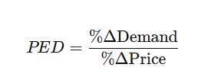
PRICE ELASTICITY
Objective:
"To analyze how changes in price impact demand for various products across different regions.“
Price Elasticity of Demand (PED) is an economic measure that quantifies how the quantity demanded of a good responds to changes in its price.
Dimensionless Parameter: PED is dimensionless because it compares the percentage change in demand to the percentage change in price, cancelling out any units (e.g., dollars, liters, or kilograms).

Slide 55
INTERPRETATION OF PRICE ELASTICITY OF DEMAND (PED)
Elastic Demand (PED < -1): Demand is highly sensitive to price changes.
Example: PED = -2.0
A 1% increase in price leads to a 2% decrease in demand.
Inelastic Demand (-1 < PED < 0): Demand is less sensitive to price changes.
Example: PED = -0.5
A 1% increase in price leads to a 0.5% decrease in demand
Positive PED (PED > 0): Uncommon scenario where demand increases with price.
Example: PED = 2.5
A 1% increase in price leads to a 2.5% increase in demand.
PED Calculation:
A Random Forest Regressor was trained using features such as labor force, unemployment rate, price index, unit value mean (price), and more.
The target variable was Purchase_grams_wtd, which represents the quantity of food purchased.
For each combination of EFPG_name (food category) and Metroregion_name (city), the feature values corresponding to December 2018 were passed to the trained model.
The model predicted the demand (Purchase_grams_wtd) for that month.

Slide 56
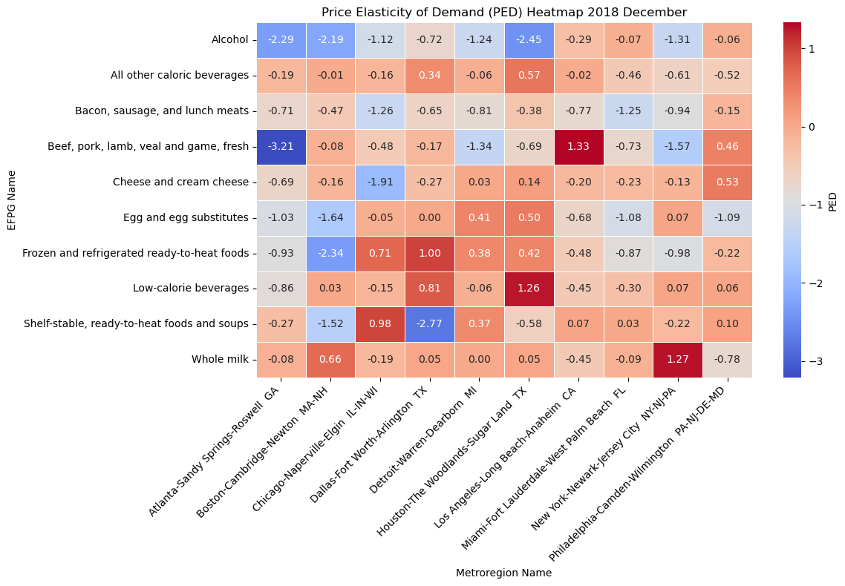

INTERPRETATION OF PRICE ELASTICITY OF DEMAND (PED)
Percentage Change in Demand = $\frac{Predicted Demand\left(Dec 2018\right)−Actual Demand(Nov 2018)}{Actual Demand(Nov 2018)}$ $×100$
Percentage Change in Price = $\frac{Price\left(Dec 2018\right)−Price(Nov 2018)}{Price(Nov 2018)}$ $×100$
PED = $\frac{Percentage Change in Demand}{Percentage Change in Price}$

Slide 57
CONCLUSION
Analyzed seasonal trends and regional demand variations using time-series models like ARIMA.
Developed predictive models to quantify price elasticity for high-demand categories, enabling informed dynamic pricing strategies.
Integrated socioeconomic data with pricing and demand metrics to build robust, data-driven models for inventory and pricing decisions.
Utilized advanced time-series forecasting models like ARIMA and Exponential Smoothing to predict future demand trends across various food categories and regions, ensuring proactive decision-making for pricing and inventory strategies.
Urban Planners Supporting Food Supply Chains: City governments or urban planners can use our models for both demand prediction and forecasting to ensure efficient food supply chain management. For example, predictive models can identify key factors influencing demand for items like dairy and eggs, while time-series forecasting models can capture seasonal patterns and trends, enabling accurate projections of demand fluctuations during holidays. This combined approach helps align supply chain logistics, ensuring adequate inventory, minimizing food waste, and stabilizing prices across metropolitan areas.

Slide 58
REFERENCES
Navin Prasath, M., et al. (2023). Time Series Forecasting and Modeling of Food Demand Supply Chain Based on Regressors Analysis. IEEE Access, 11, 12034-12050.
Vergara, M., et al. (2023). Demand Forecasting for Daily Retail Orders in Fresh Food Market. IEEE Transactions on Industrial Informatics, 15(3), 548-558.
Bekele, M., et al. (2021). A Machine Learning Approach to Forecast the Food Prices for Food Security Issues. Journal of AI for Sustainable Development, 5(1), 62-79.

Slide 59

THANK YOU

